Slide 1
Graduate Programme
Commercial Awareness
Andrew Reeves

Slide 2
COMMERCIAL AWARENESS
How do agencies make money?

Slide 3
HELLO

Slide 4
Exercise
Where does profit come from?
Notes:
Ice breaker

Slide 5
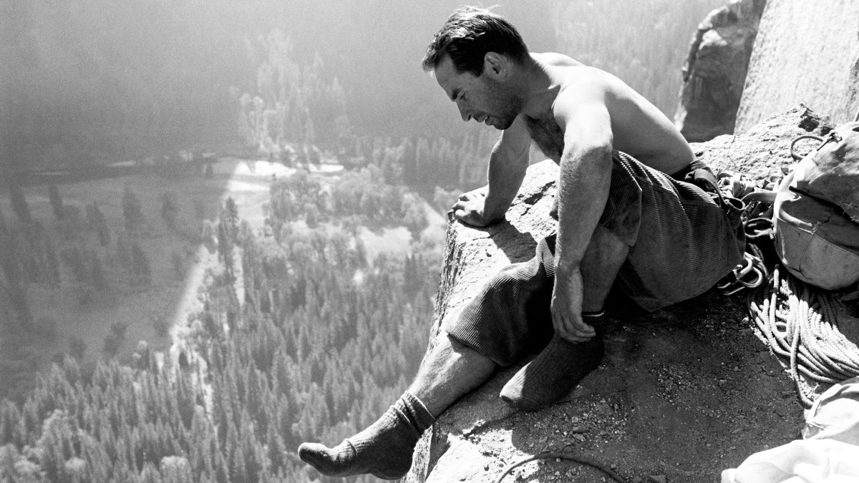
“Profit is what happens when you do everything else right”
Yvonn Chouinard

Slide 6
Exercise
How is profit calculated?
Notes:
Survive
Grow
Deliver
Invest
How much depends on your individual circumstances

Slide 7
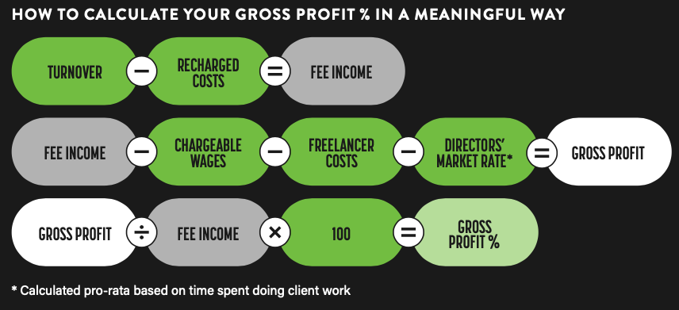
Notes:
2021 WOW agency

Slide 8
INDIRECT
COSTS
OPERATING
PROFIT
Notes:
2021 WOW agency

Slide 9
Exercise
How much profit is enough?
Notes:
Survive
Grow
Deliver
Invest
How much depends on your individual circumstances

Slide 10
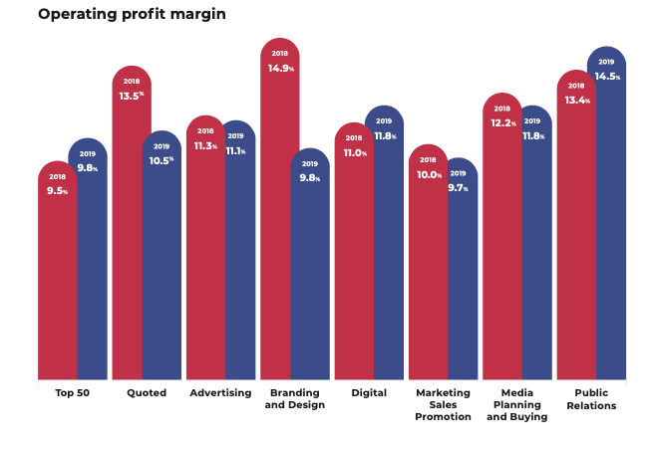
Notes:
2019 Kingston Smith

Slide 11
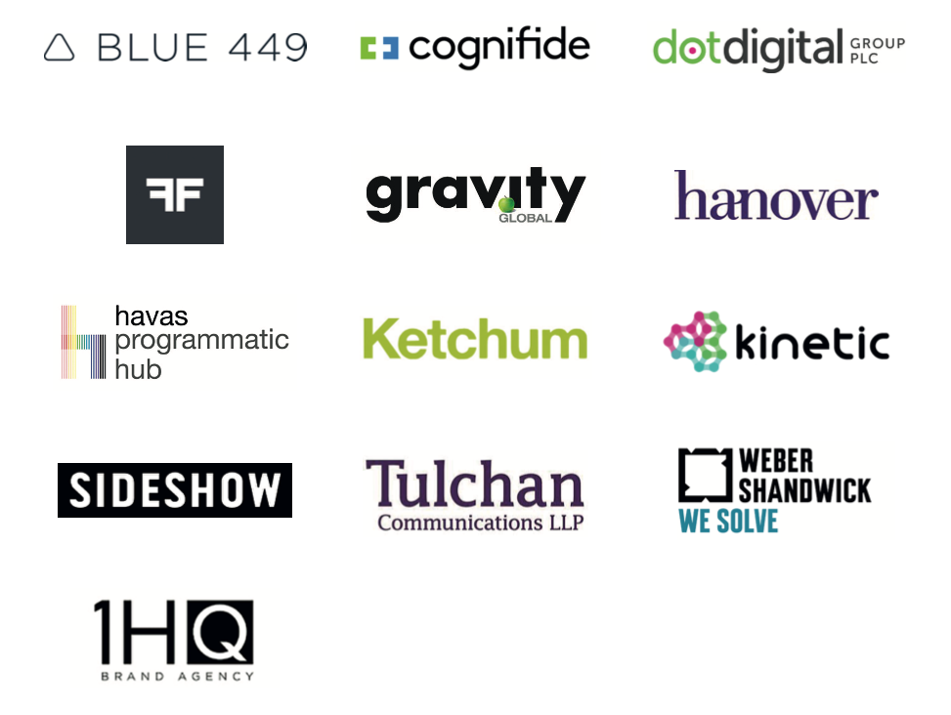
OUTLIERS

Slide 12
Exercise
How big is our sector?
Notes:
Survive
Grow
Deliver
Invest
How much depends on your individual circumstances

Slide 13
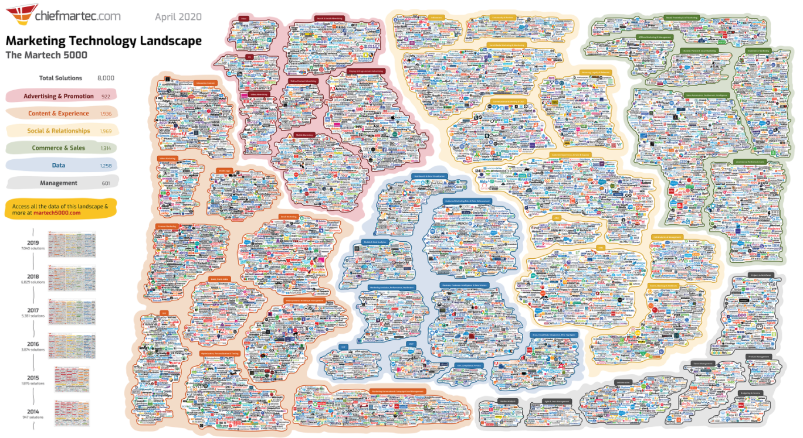
Notes:
Chiefmartec 2020

Slide 14
Exercise
Why are some agencies more profitable than others?
Notes:
10mins….
People
Clients
Product
Society

Slide 16
A
A
A
FRAMEWORK
AMBITION
ARCHITECTURE
ACHIEVEMENT

Slide 17
A =
3
t

Slide 18
A
The long term intent of the business in relation to its owners, employees, customers and the wider world
AMBITION
Notes:
Can come in many forms

Slide 19
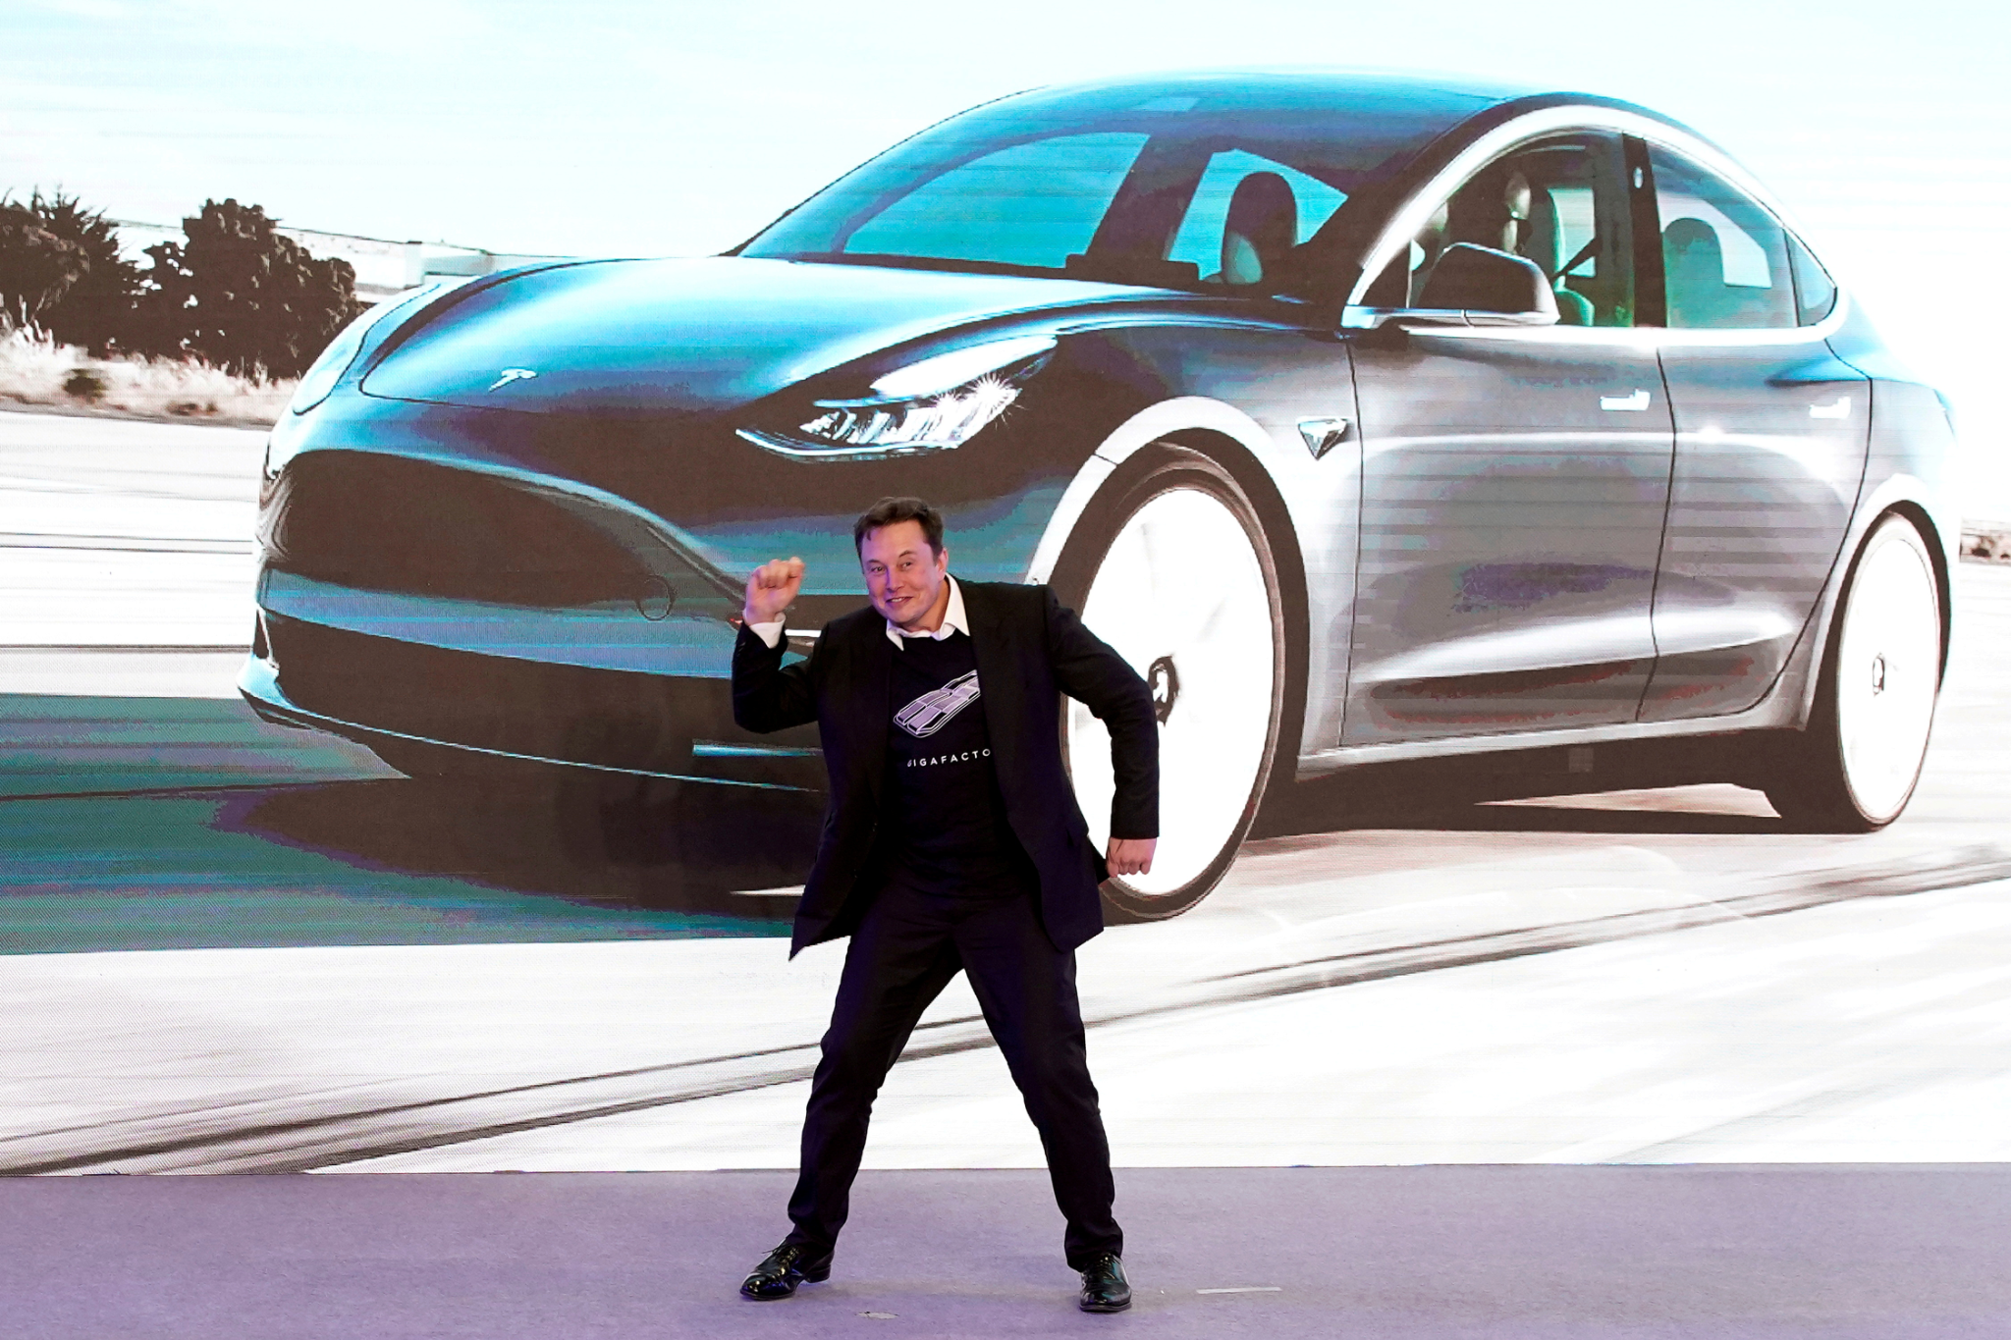
TO ACCELERATE THE WORLD’S TRANSITION TO SUSTAINABLE ENERGY
Notes:
Sustainability

Slide 20
PEOPLE DON'T KNOW WHAT THEY WANT UNTIL YOU SHOW IT TO THEM
Notes:
Product Development/ Innovation

Slide 21
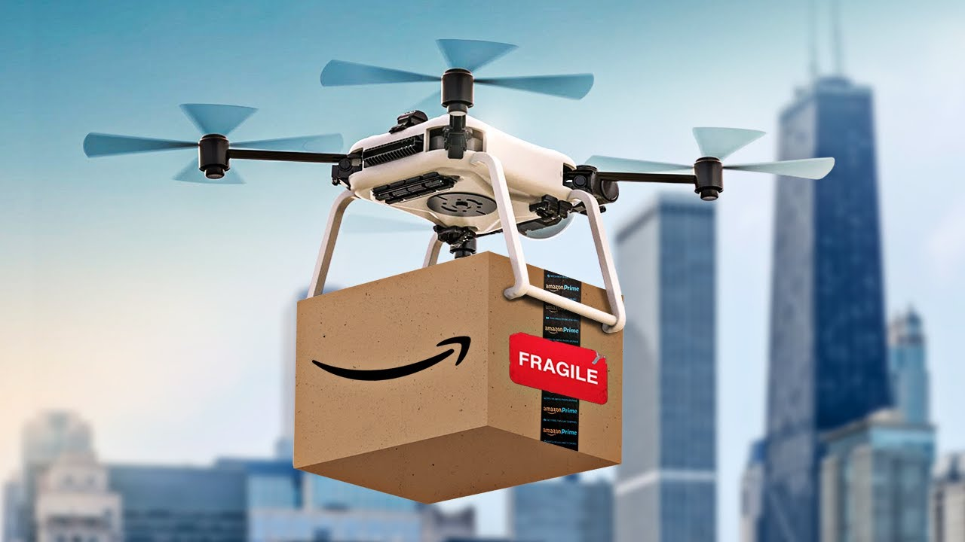
WE STRIVE TO OFFER OUR CUSTOMERS THE LOWEST POSSIBLE PRICES, THE BEST AVAILABLE SELECTION, AND THE UTMOST CONVENIENCE
Notes:
Customer

Slide 22
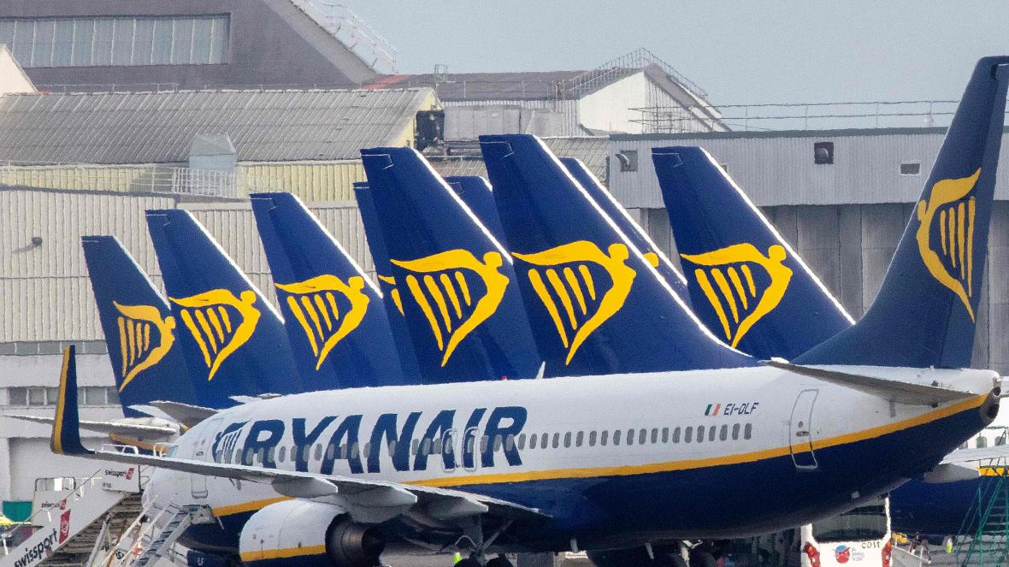
TO OFFER LOW FARES THAT GENERATE INCREASED PASSENGER TRAFFIC WHILE MAINTAINING A CONTINUOUS FOCUS ON COST CONTAINMENT AND EFFICIENCY OPERATION
Notes:
Cost structures

Slide 23
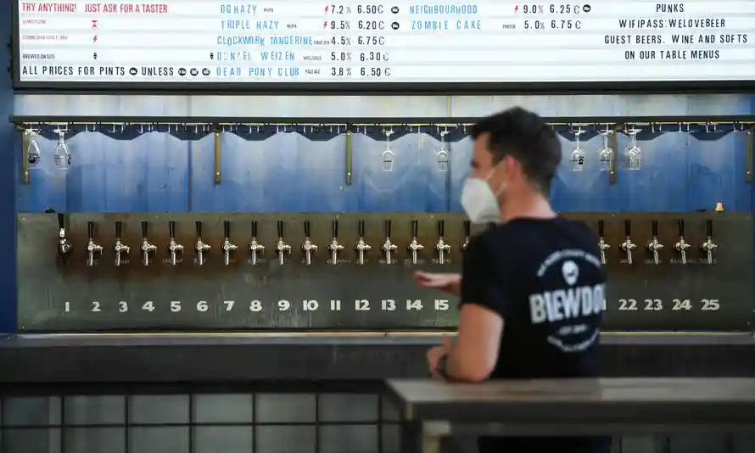
OUR MISSION IS TO MAKE OTHER PEOPLE AS PASSIONATE ABOUT GREAT CRAFT BEER AS WE ARE
Notes:
Beer...but

Slide 24
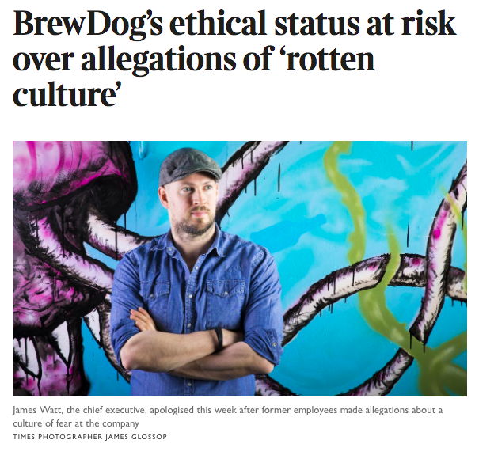

Slide 25
Exercise
What is the core ambition of your agency
Notes:
Known, or perceived….

Slide 27
A
The foundation of which an organisation is built and it’s governing laws to ensure it achieves its ambition
ARCHITECTURE

Slide 28
ARCHITECTURE
Innovation
Innovation
Innovation
Value
Creation

Slide 29
Exercise
What are the key functions within an agency?
Notes:
Because on balance, they are better at certain things

Slide 30
Agency
Strategy
Business
Partner
Project
Delivery
Insight
Product
Development
Business
Development
Marketing & PR
Commercial
Management
Talent
Management
FUNCTIONS

Slide 31
Agency
Strategy
WHAT
WHEN
HOW
WHO
Notes:
Not good enough to have an Ambition...needs to be operationalised.
Do you have an agency strategy...do you know what it is?

Slide 32
Business
Partner
PROACTIVE
AVAILABLE
SOLUTION ORIENTATED
Notes:
How to achieve this?
Become a respected advisor
Why is this important?
Increases your value….both in terms of loyalty and price point

Slide 33
Project
Delivery
CLIENT MANAGEMENT
Notes:
Run Billy Connolly ‘I want it now’
Eg Ryanair
Who does this in your agency?

Slide 34
Project
Delivery
ON TIME
ON BUDGET
ON QUALITY
Notes:
Run Billy Connolly ‘I want it now’
Eg Ryanair
Who does this in your agency?

Slide 35
Insight
INTELLIGENT
SURPRISING
HELPFUL
Notes:
Eg add to brief
Quarterly reviews
Sector reviews

Slide 36
Product
Development
BETTER
FASTER
CHEAPER
Notes:
Tech/ Ways of working/ outsouring
What has changed in your agency that you know of recently?

Slide 37
Business
Development
REDUCE RISK
IMPROVE DIVERSITY
INCREASE INSIGHT
CREATE SCALE
Notes:
How much of your business is leaky bucket?

Slide 38
Marketing & PR
ATTRACT TALENT
ATTRACT CLIENTS
CELEBRATE SUCCESS
Notes:
How did you come about finding your job
How would you make that experience better?

Slide 39
Commercial
Management
PRICING
WOW
NEGOTIATIONS
REPORTING
Notes:
Show the economist Dan Ariely video

Slide 40
Talent
Management
RECRUITMENT
INTEGRATION
DEVELOPMENT
EXPERIENCE
Notes:
The right people for the job will improve productivity save money etc….

Slide 41
Agency
Strategy
Business
Partner
Project
Delivery
Insight
Product
Development
Business
Development
Marketing & PR
Commercial
Management
Talent
Management
MANAGEMENT
ACCOUNT MANAGEMENT
PROJECT MANAGEMENT
STRATEGY
RESOURCES
CREATIVE & DESIGN
ENGINEERING/TECH
TALENT
OPERATIONS
FINANCE
Notes:
How much resource is involved across each function

Slide 42
Agency
Strategy
Business
Partner
Project
Delivery
Insight
Product
Development
Business
Development
Marketing & PR
Commercial
Management
Talent
Management
MANAGEMENT
ACCOUNT MANAGEMENT
PROJECT MANAGEMENT
STRATEGY
RESOURCES
CREATIVE & DESIGN
ENGINEERING/TECH
TALENT
OPERATIONS
FINANCE
Notes:
How much allocated resource is rechargeable to client in a classic T&M

Slide 43
Agency
Strategy
Business
Partner
Project
Delivery
Insight
Product
Development
Business
Development
Marketing & PR
Commercial
Management
Talent
Management
MANAGEMENT
ACCOUNT MANAGEMENT
PROJECT MANAGEMENT
STRATEGY
CLIENT FACING
CREATIVE & DESIGN
ENGINEERING/TECH
TALENT
OPERATIONS
FINANCE
ROUGHLY ONLY 1/3RD OF RESOURCE IS CLIENT FACING

Slide 44
INDIRECT
COSTS
OPERATING
PROFIT
Notes:
2021 WOW agency

Slide 45
Agency
Strategy
Business
Partner
Project
Delivery
Insight
Product
Development
Business
Development
Marketing & PR
Commercial
Management
Talent
Management
MANAGEMENT
ACCOUNT MANAGEMENT
PROJECT MANAGEMENT
STRATEGY
CLIENT FACING
CREATIVE & DESIGN
ENGINEERING/TECH
TALENT
OPERATIONS
FINANCE
ROUGHLY ONLY 1/3RD OF RESOURCE IS CLIENT FACING

Slide 46
Revenue = Capacity x Efficiency x Cost Plus Price
Vs.
Profitability = Intellectual Capital x Price x Effectiveness
= [Human Capital + Structural Capital + Social Capital] x [price] x [doing things right]
HOURLY RATE DILEMMA
Notes:
2021 WOW agency

Slide 48
A
A
A
FRAMEWORK
AMBITION
ARCHITECTURE
ACHIEVEMENT

Slide 49
A
The yardstick to which all your ambitions are measured.
ACHIEVEMENT

Slide 50
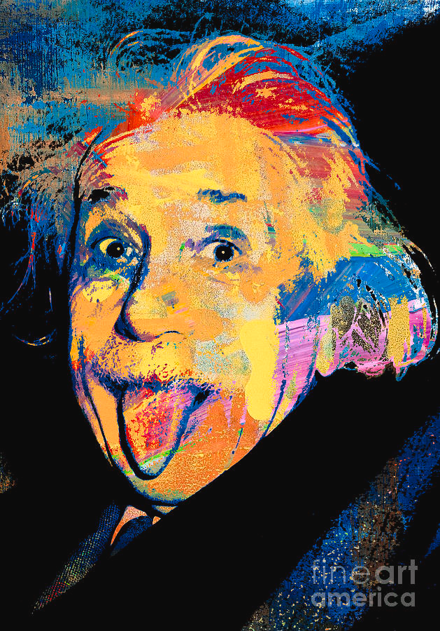
“Sometimes what counts can’t be counted, and what can be counted sometimes doesn’t count”
Albert Einstein

Slide 51
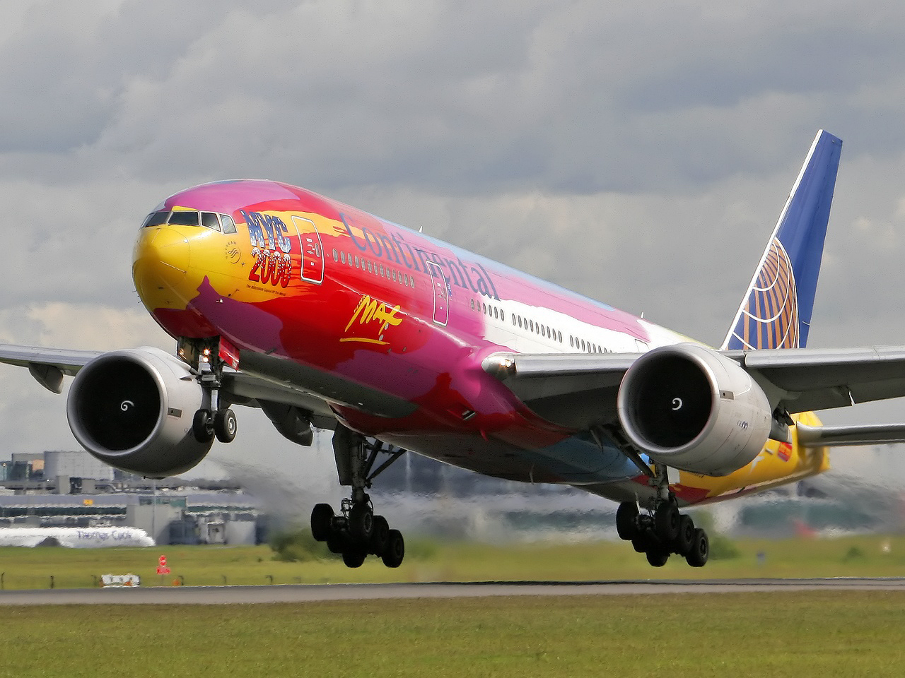

Slide 52
‘70’s, filed for bankruptcy when KPIs were cost and profit
80’s, filed for bankruptcy also when KPI were cost and profit
90’s, 3 KPI’s alternative KPI’s introduced
…and dramatically turned the business around
On time arrival
Lost Luggage
Customer complaints
CONTINENTAL
From worst to first, Gordon Bethune

Slide 53
Exercise
What does your agency measure?

Slide 54
NPS SCORE
AVERAGE TENURE
COMPLAINTS
REFERRALS
SHARE OF WALLET
CUSTOMER

Slide 55
LEVEL OF APPLICANTS
CHURN
PIP’S
ENGAGEMENT
DIRECT FEEDBACK
PEOPLE

Slide 56
R&D
PRODUCTISATION
AWARDS
PR
PRODUCT

Slide 57
R&D
PRODUCTISATION
AWARDS
PR
SOCIETY

Slide 58
£
GROSS MARGIN
REVENUE PER HEAD
SCR
OPERATING PROFIT
GROWTH
FINANCIAL

Slide 59
A =
3
t
AMBITION
SUSTAINABLE
PROFIT
ARCHITECTURE
ACHIEVEMENT

Slide 60
THANKS

