Slide 1
The Changing Face of Client Servicing
Jamie Matthews
March 2021

Slide 2
The Changing Face of Client Servicing
>
>
>

Slide 3
When we did business with this

Slide 4
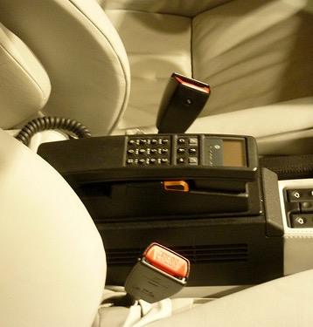
And this

Slide 5
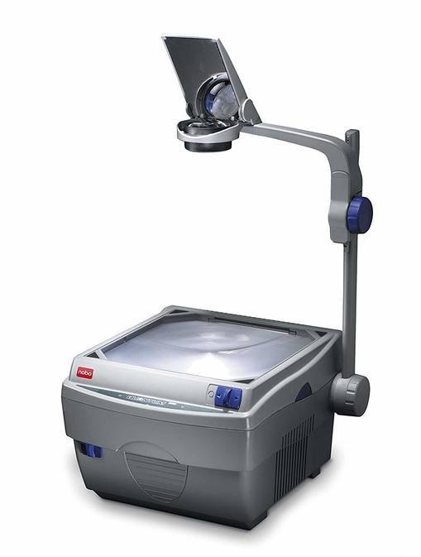
And this

Slide 6
And even at a push, this…..

Slide 7
Client Servicing was relatively transactional.
Few people in support, bought in creative, no planning, no studios, no multi-channels, no all agencies.
Time was spent keeping tabs on Clients from afar and tech that needed man marking…..

Slide 8
Q: ‘What percentage of the knowledge you needed to do your job was stored in your own mind in…..
1986:
1997:
2008:
This has resulted in a shift in skills sets from the more functional to…..
……increasing emphasis on teamwork, collaboration, communication and empathy.
75%
15%
10%

Slide 9
Reading the room
>
>
The Changing Face of Client Servicing
>

Slide 10
IQ determines 20-25% of business success
EQ determines 70-75% of business success

Slide 11
IQ
Balanced performance
Decision Making
EQ
Self Awareness
Motivation
Self Management
Social Skills
Empathy

Slide 12
We respond to situations based on our perception.
We can choose to look at things from others’ point of view (empathy) or to stay fixed on our own…..

Slide 13
Competencies
Perceptions of others
Listening
Empathy
Social awareness
Your ability to understand other people, to accurately pick up on emotions in other people and understand what is really going on with them.
It means perceiving what other people are thinking and feeling even if you do not think and feel the same way.

Slide 14
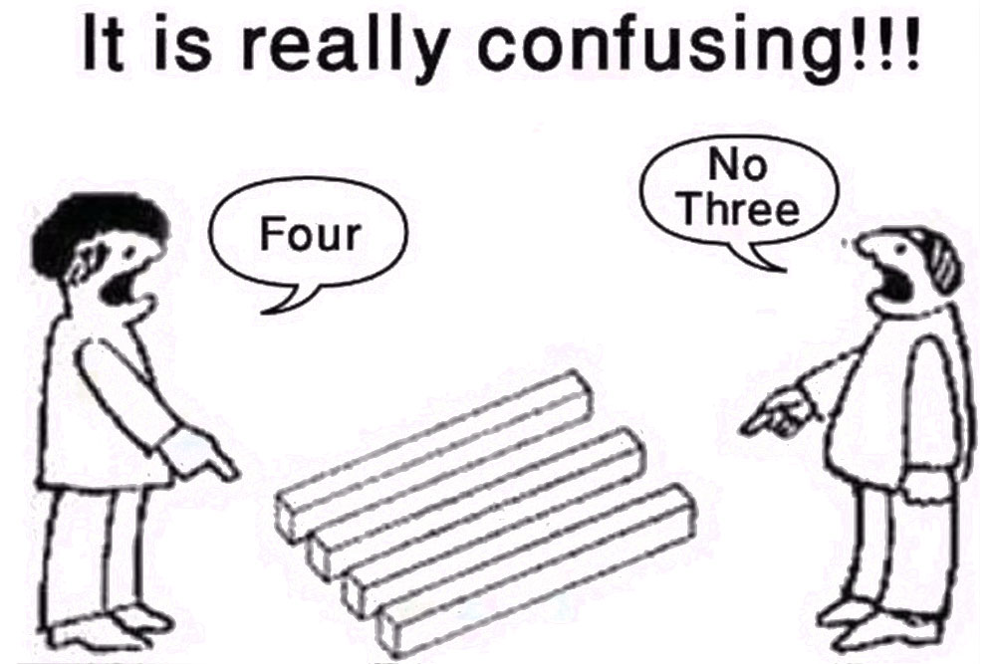
Perceptions
How we perceive what is going on in any given moment is influenced by our filters.
One of the most common perceptual filters is seeing what we expect to see: Stereotyping
E.g., a new colleague arrives at work, unsmiling.
We perceive them as unfriendly.
We put an unfriendly label on that person.
That label affects how we relate with them in the future.

Slide 15
Listening
>
>
The Changing Face of Client Servicing
>

Slide 16
Listening

Slide 17
Listening - Six Negative Listening Habits
THE FAKER: You appear to be listening, but your mind is elsewhere
THE INTERUPTER: You are too impatient to listen
THE INTELLECTUAL: You don’t listen to the words, just try to fit them in to your logic
THE HAPPY HOOKER: You take what the speaker is saying and try and out do it
THE REBUTTAL MAKER: You use the speakers' words to try and prove them wrong
THE ADVICE GIVER: You don’t always explore feeling before jumping in with solutions

Slide 18
Being more entrepreneurial
>
>
The Changing Face of Client Servicing
>

Slide 19
Project fees are winning over retainers
INCOME
Retainer
fees
Project
fees
TIME

Slide 20
Success lies in having an entrepreneurial spirit
THE KEY TRAITS OF A SERIAL ENTREPRENEUR
Based on a control group of 17,000 working adults, serial entrepreneurs tested above average in the following skills:
ABOVE THE CONTROL GROUP’S AVERAGE
Persuasion
Leadership
Personal Accountability
Goal Orientation
Interpersonal Skills
+1.17
+1.02
+.86
+.48
+.03
SOURCE TARGET TRAINING INTERNATIONAL
HBR.ORG
Jobs won’t just come to you

Slide 21
How are you going to make money this week ?
Generate a proactive idea?
Send an “I saw this and thought of you”?
Research a key client competitor?
Pick up
the phone?
Just a written one. No need to engage creative. Run it by your BUD or Board Representative and then send it to
your Client
Find an excuse to get back in touch with a “resting” client by sending them an article you think may interest them
Then send the findings to your client. It says you are thinking of them and could spark a brief. If nothing else you’ll learn something
And chase down that brief your Client mentioned. The quicker it comes in the quicker income hits the bottom line

Slide 22
Use the experience around you
>
>
The Changing Face of Client Servicing
>

Slide 23
Progress in the workplace is not judged on presenteeism
It is judged on demonstrating the maturity to want to learn and to have the confidence of saying…
”I don’t know how….”
or
“How could I….”

Slide 24
Develop Allies
>
>
The Changing Face of Client Servicing
>

Slide 25
Make friends with other agencies

Slide 26
Focus yourselves and your clients
>
>
The Changing Face of Client Servicing
>

Slide 27
Making effective use of time
Listen to what’s going on around you
Generate planning time in your diary – every week
Identify ‘sprints’ for projects and block out time in your calendar
Stop spending time marshalling your inboxes to within an inch of their lives
Book meetings for half the time you would normally
Find your space – mental and physical where concentration is king

Slide 28
Adapt your techniques to the virtual world
>
>
The Changing Face of Client Servicing
>

Slide 29
Zooming in…
Keep email threads moving in the right direction
Don’t be afraid to pick up the phone (it makes a nice change!)
Make sure everyone is fully present on the zoom call (and that your backgrounds are neat and tidy)
Avoid the trap of filling the room with chat
Silence can be golden
Sort out your practicals with the team prior to the zoom call
Name the fear around commercials to understand a go/no go opportunity

Slide 30
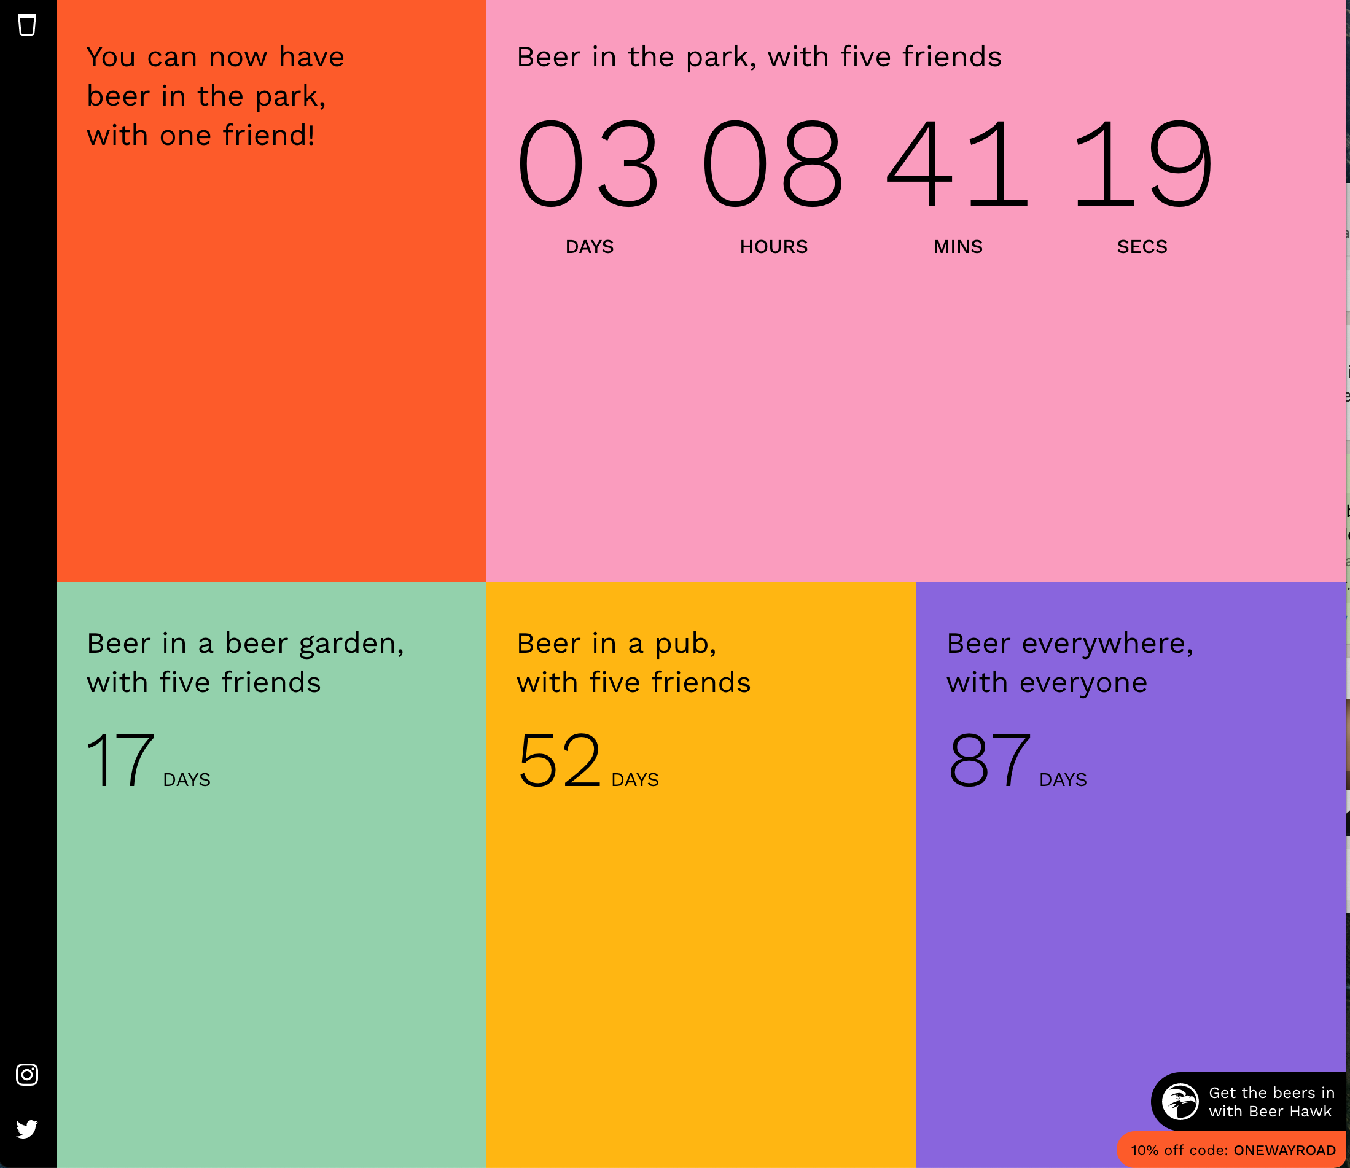
Final thought…
As lock down eases, unlock those client relationships…by maximizing your client entertainment budgets!
https://onewayroadtobeer.com/

Slide 31
Summary
#1 Read the room
#2 Be more entrepreneurial
#3 Use the experience around you
#4 Develop allies
#5 Focus yourselves and your clients
#6 Adapt your techniques to the virtual world

