Slide 1
Building Strong Client Relationships
March 31st, 2021
Nick Adams, CEO, Sense

Slide 2
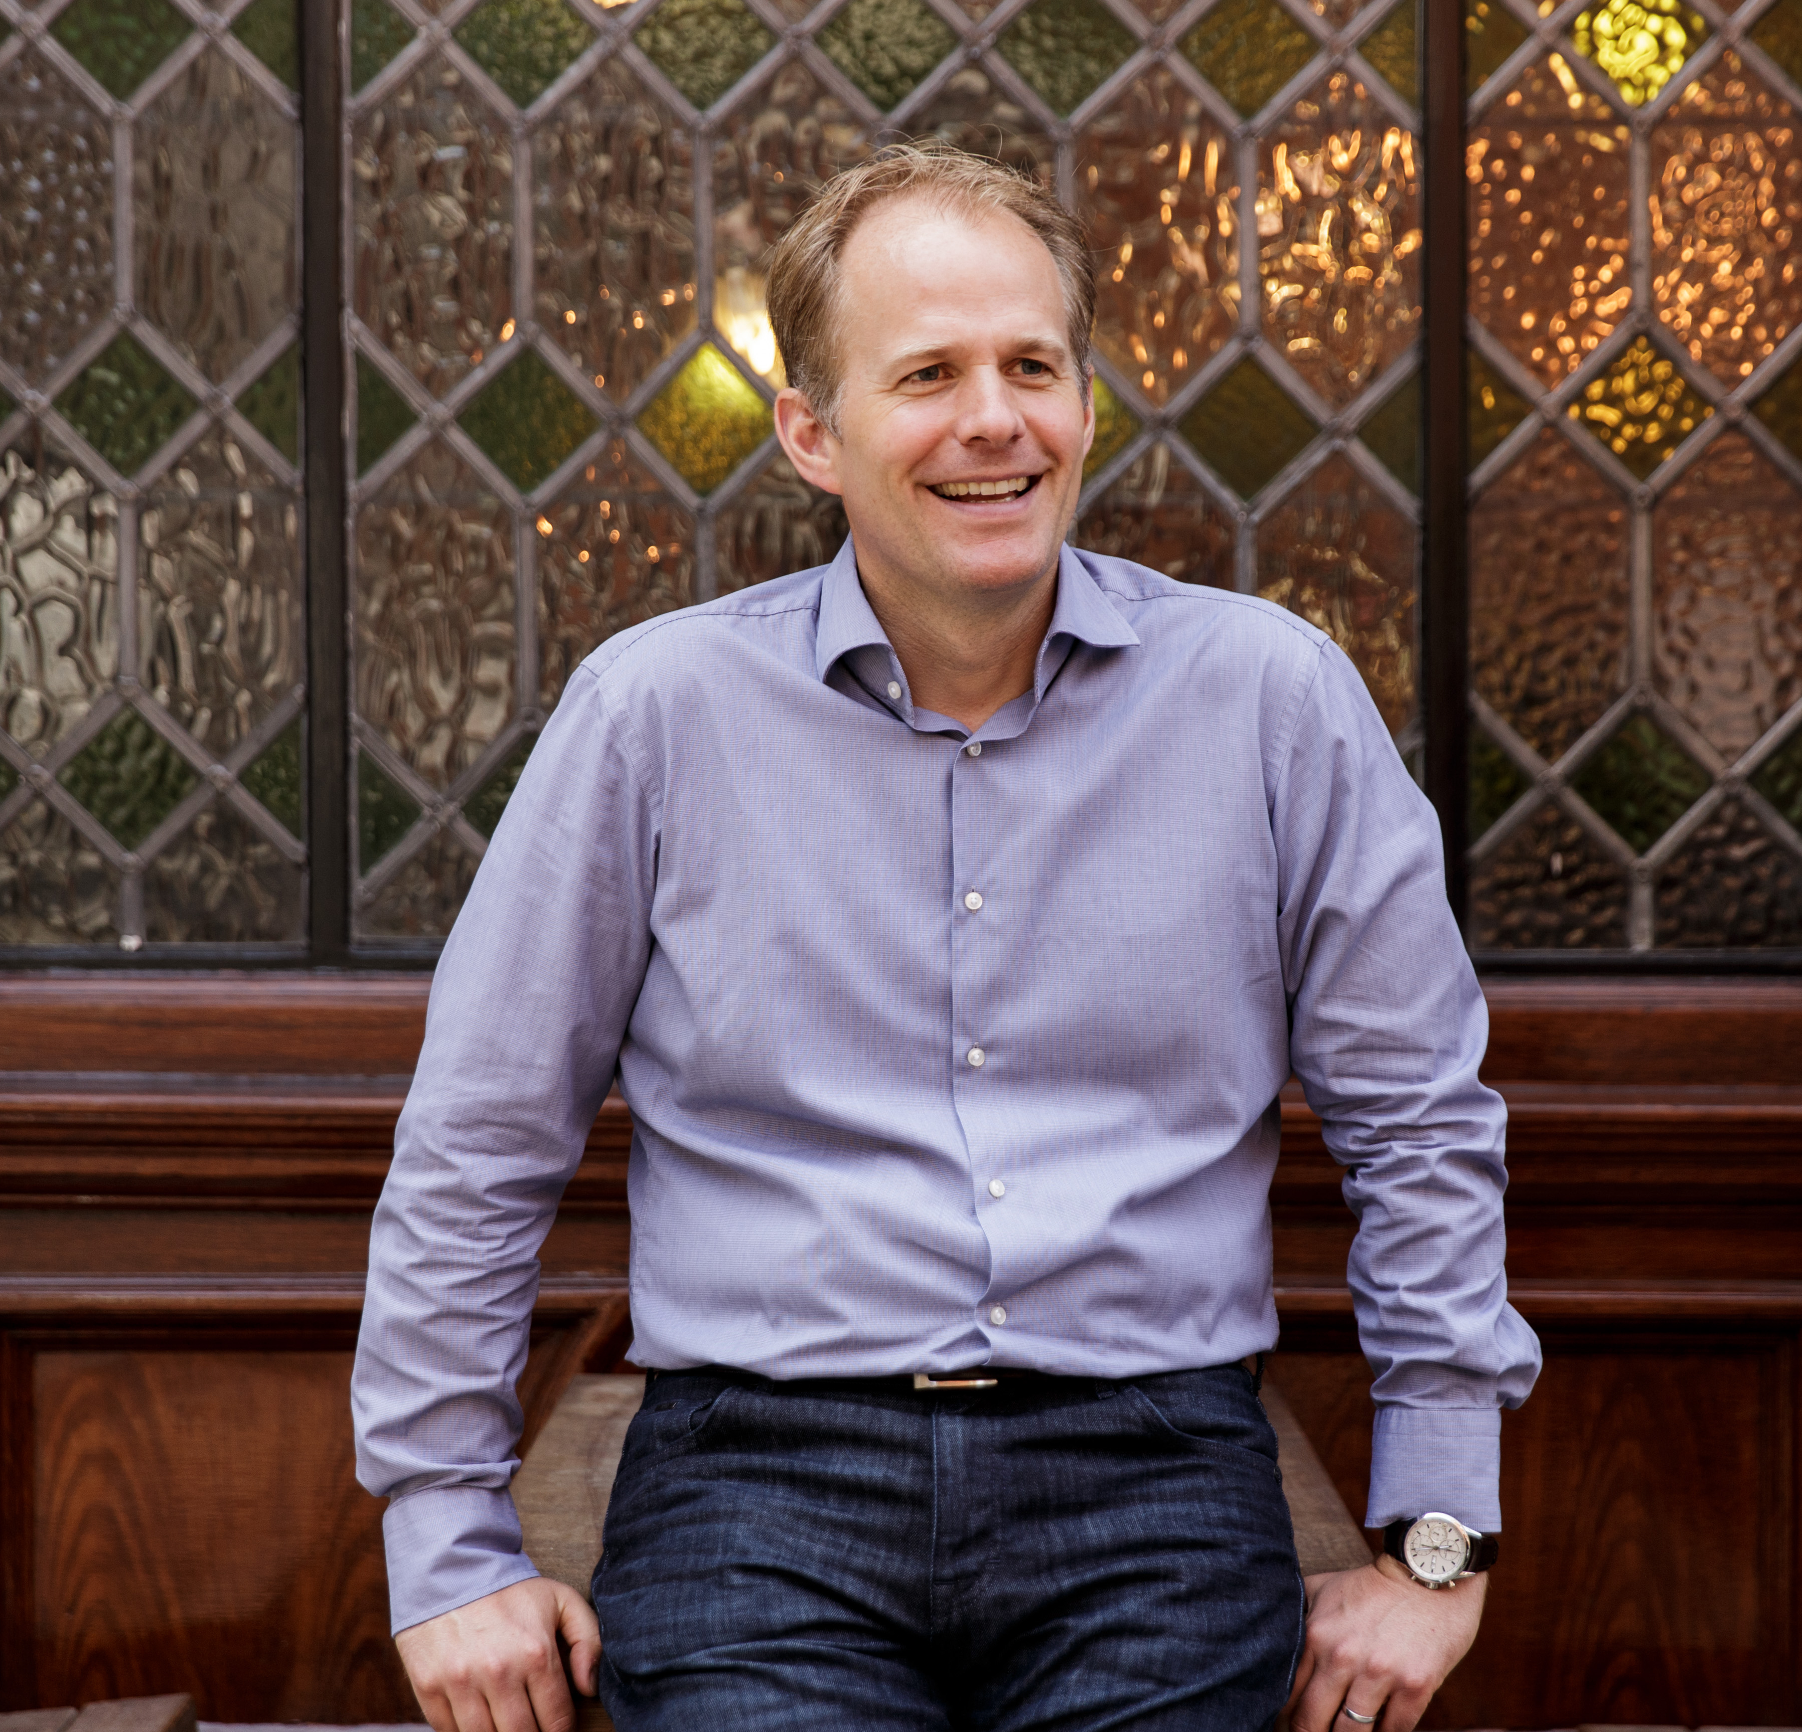
About me
Nick Adams, Managing Director, Sense
20+ years working in below-the-line agencies
Triangle Communications > LIME (experiential specialist)
Founded Sense in 2005
…haven’t really ever got away from day to day Client relationships!
nick.adams@senselondon.com
https://www.linkedin.com/in/nick-adams-131b272/

Slide 3
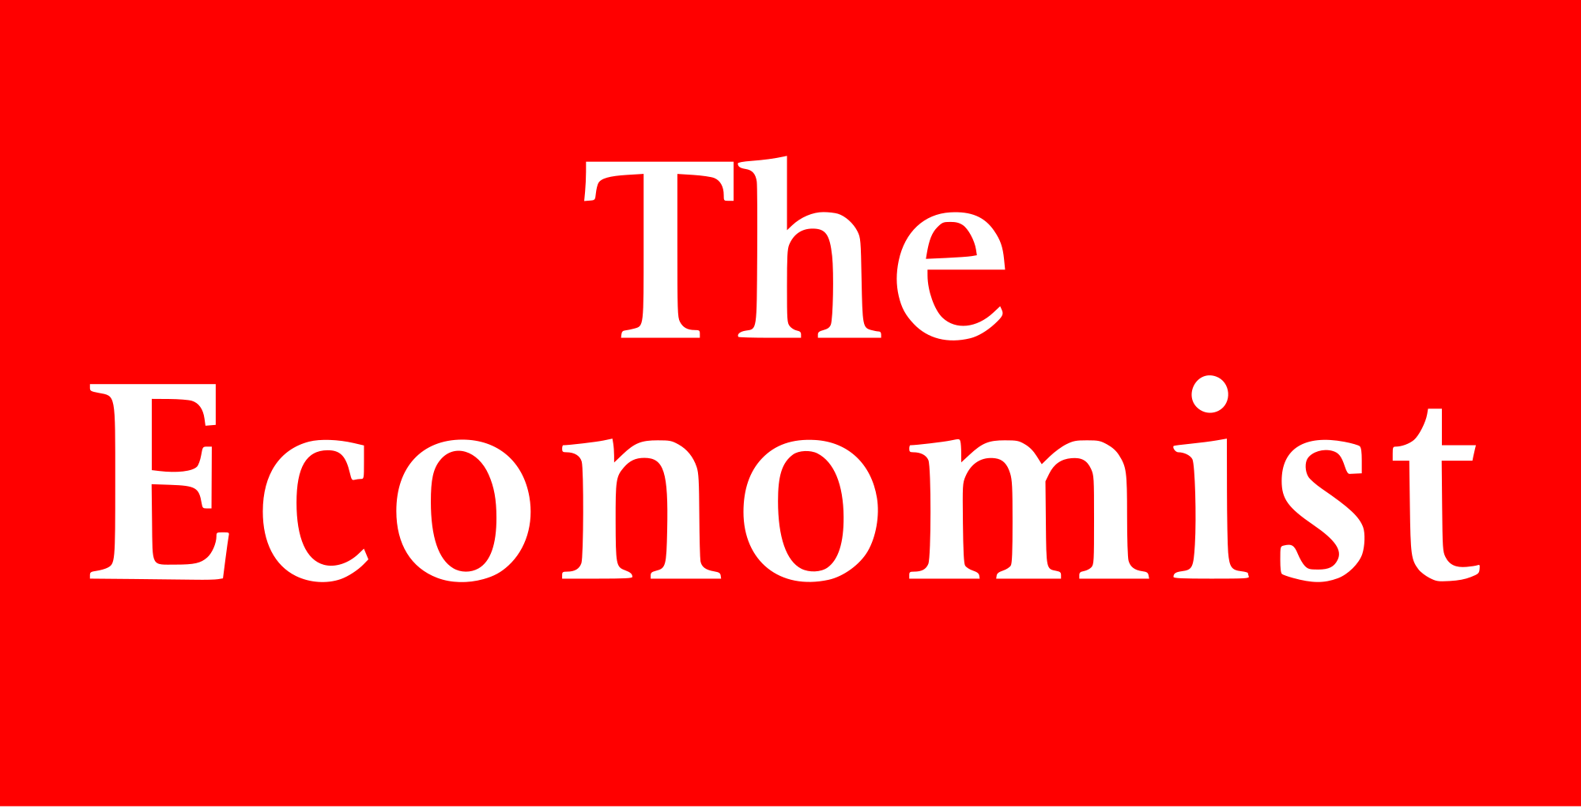
Strong Relationships - Traits
Personable │Challenging│ Honesty │ Flexibility │ Empathy

Slide 4
But before we dive in

Slide 5
Personable
People buy people!
Client’s make emotional, not rational decisions
Relationships last, not because you deliver the best work every single time
Remember….no one ever built a really solid relationship on email!

Slide 6
Challenging
The Client is not always right!
‘Do for me’ vs ‘think for me’ – which creates the stronger relationship?
Strive to be as indispensable as you can be (it’s what’ll differentiate you)
Be important to your Client because you’re also important to their business

Slide 7
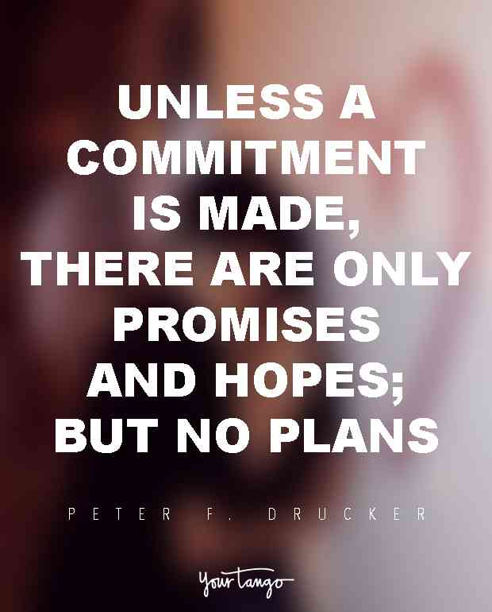
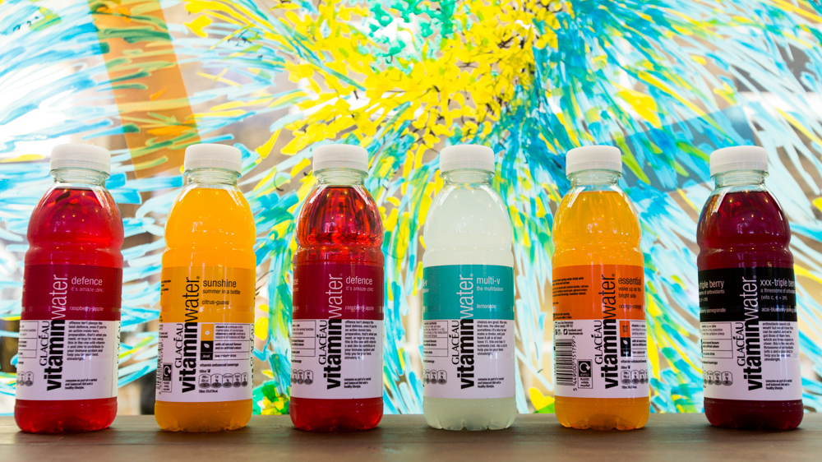
Challenging
Context
A pitch request to 9 agencies
JFDI; ‘it’s our usual approach’; costing exercise
Approach
Interrogated and questioned the request
Re-framed the problem > collaborated to write a brief > stake holder buy-in
Consequence
Set the tone for our relationship (respect + value)
Receptive to our solution > agency differentiation
Success breeds positivity

Slide 8
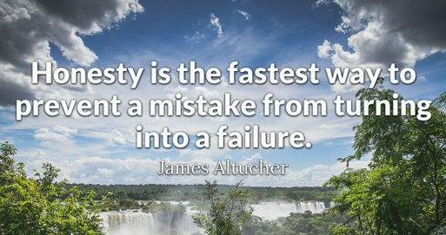
Honesty
…really is the best approach!
No one is perfect all of the time
Play the long game (aren’t your oldest friends your most honest ones?)
Tip – do you know the ‘Values’ of your Client’s business? – Openness?, Integrity, Transparency?

Slide 9
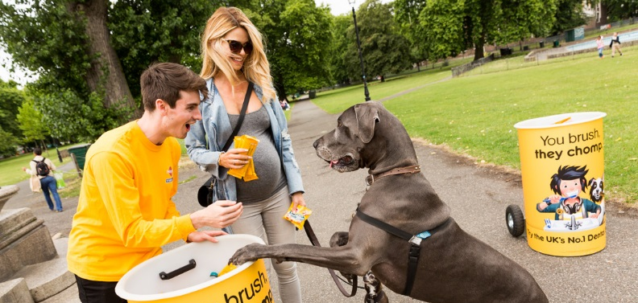
Honesty
Context
Mars Petcare, mass sampling activation
A new client; strict agency KPI’s
…eeek, we under-delivered!
Approach
The difficult option – full transparency!
Delicate education > a mutual solution > amended future planning
Consequence
A new exclusive relationship (avoiding pitches)
New metrics for all future campaigns

Slide 10
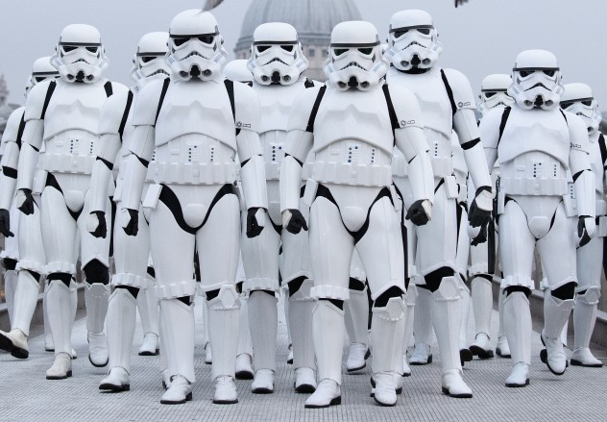
Flexibility
Client’s are not an homogeneous group!
Companies don’t work in a particular way…individuals do
People like working with people who work like them
What is your Client’s style? How have you adapted your approach?

Slide 11
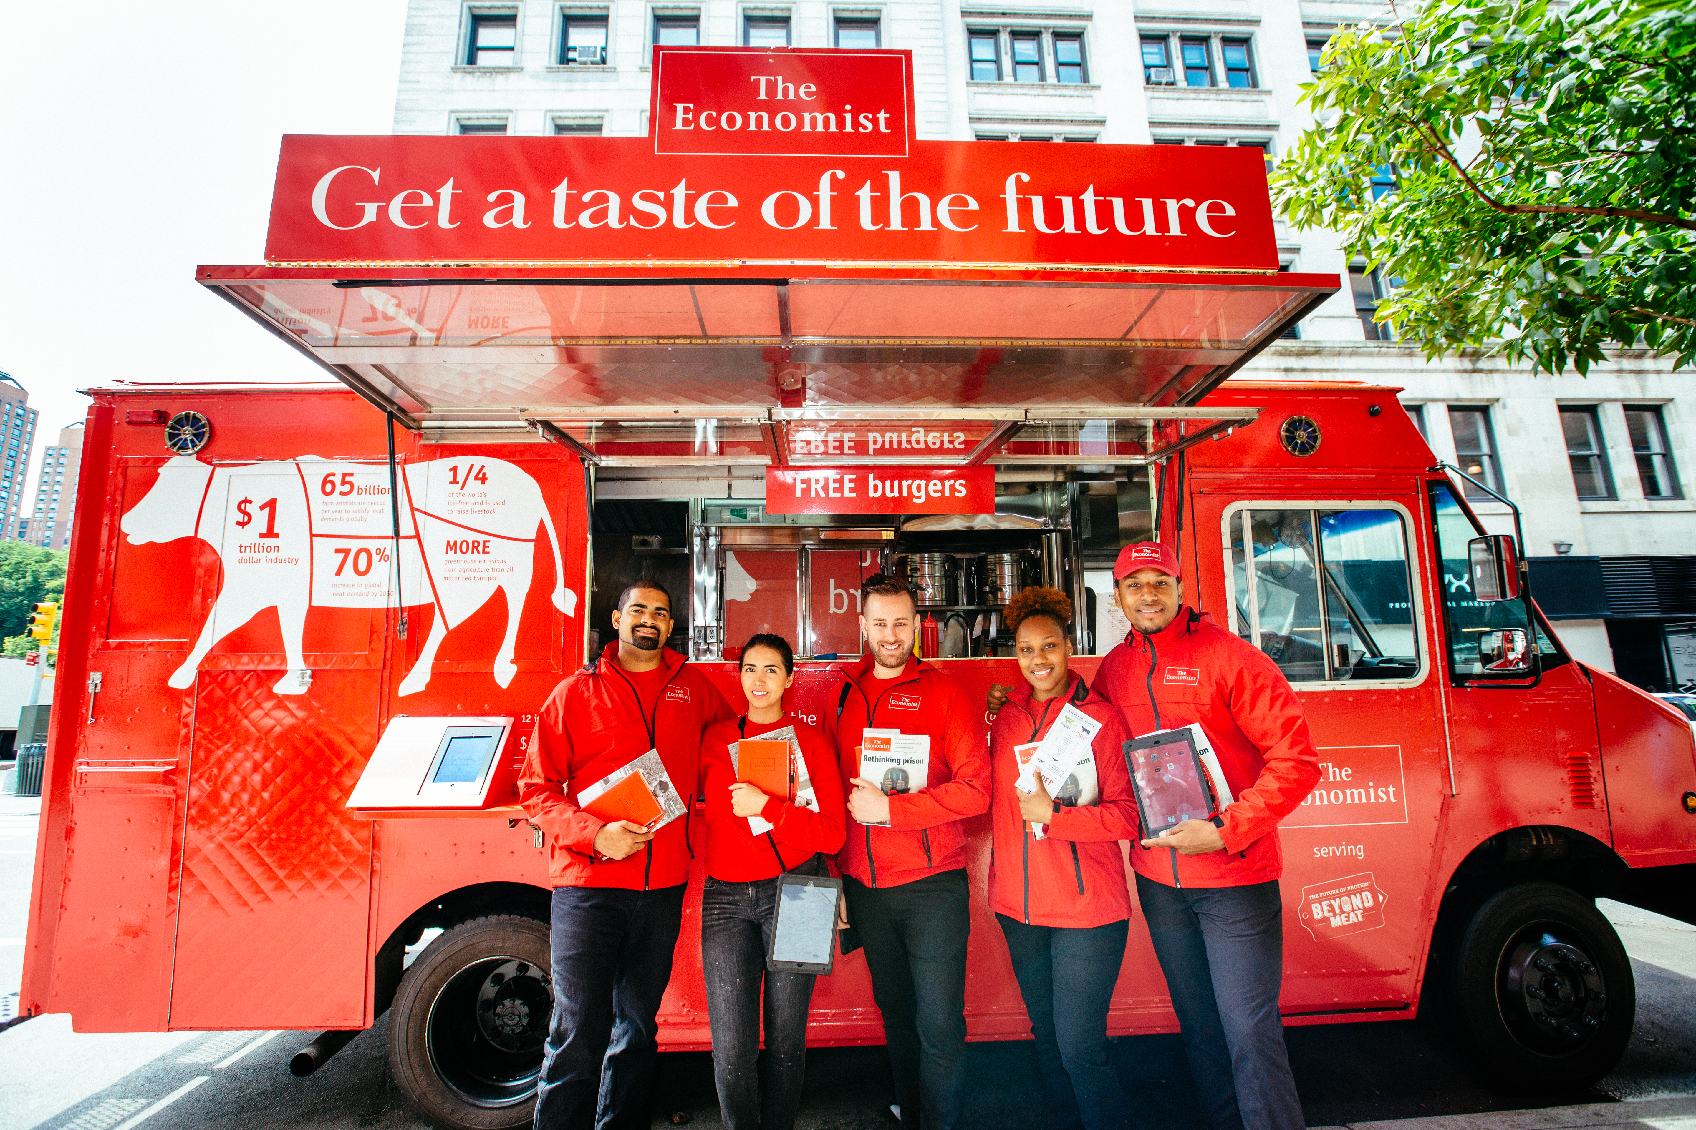
Flexibility
Context
The Economist, always on activation in UK & US
Two entirely different senior Client cultures
US > senior Client ex-agency, entrenched in the detail
Approach
Consistent campaign > entirely different relationships
Ways of working highly adapted to Client style
Consequence
Relationship built on trust, friendship and loyalty
Active Client support in growing our business

Slide 12
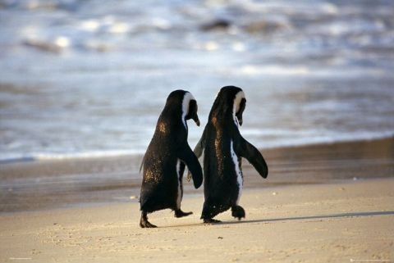
Empathy
Step into your Client’s shoes
Your mission is to make their lives easier
Business challenges, yes…but personal job pressures and problems?

Slide 13
Empathy
Context
Activation for Sea Life centres worldwide
One size fits all experiential toolkit
23 different venues > 12 languages > 1 stressed Client!
Approach
“Let’s get through this together”
Sharing the burden; direct co-ordination of stakeholders; dividing and conquering by skillset, not titles
Consequence
A happy and v. grateful Client!
Efficient processes > on schedule > project success

Slide 14
And finally…
Building great Client relationships never ends
Avoid complacency, there are constant risk factors to mitigate
Be yourself. There is no magic formula.

Slide 15
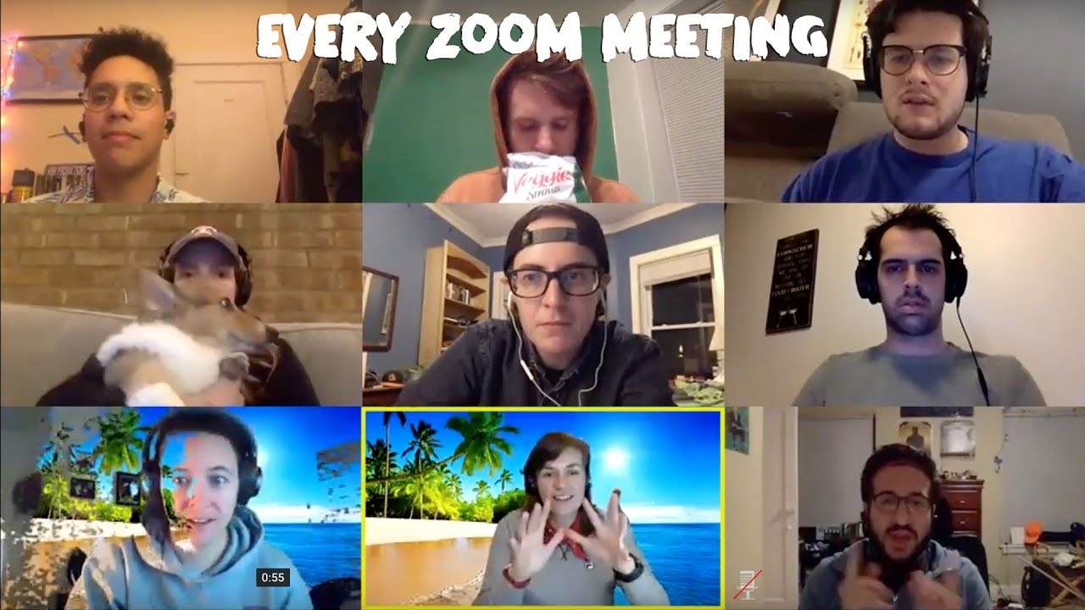

Slide 16
It’s been difficult!
02
03
01
Neurology is working overtime
Consider the
other stuff
It’s not normal
Different way of communicating
Change of focus
People are not necessarily in work mode or state
Introvert/extrovert
04
05
Making it up as
we go along
How different people respond differently to the new medium
No time to practice new techniques

Slide 17
Pros and Cons
Pros
Client availability & mindset
Meeting efficiency
Document / work sharing
WFH routines & W/L balance
Interaction!
Cons
Meeting impact (especially pitching)
Chemistry
Non verbal comms / intuition
Social ‘chat’
Brainstorm / workshops / other collaborative working

Slide 18
Some practical tips
01
02
03
Position
Posture
Projection
Proximity and centering
Effect on you and
the audience
Landing your points, make an impact
04
Disruption
Disconnect
05
06
Distraction
Where do you want the focus to be?
Effective facilitation
Conscious interactive moments

Slide 19
Practical Tips
R
Revisit tech. Assign team member to keep up to date with Zoom + Teams innovations. E.g whiteboard, breakrooms
E
Engage from the start. Create a quirky, fun, intermate connection before getting into the serious stuff.
M
Make time for responses. Stop, take a breath, call out names, pause. All these tactics prevent passive listening.
O
Output. Plan your meeting, and be clear of the outcome you are trying to achieve from the offset.
Test test test. Practice big presentations, record yourself and play back, get a team member to pretend to me the client and feedback.
T
E
Energy. Create a cohesive and collective energy with other team members on the call – consider this through the backgrounds, dress and feeling you want to bring to the call.

Slide 20
Take-aways
Log into pitches / client presentations 5 minutes early to check: team positioning, posture, lighting and backgrounds.
Chose a lead for the call. They should open the meeting by outlining the agenda and tone of the presentation to come.
Stay engaged as your team member talks, nod encouragingly and engage with what they are saying through your body language.
Remember the value of the pause. Don’t be afraid of it.
Call out the client’s name and address them directly throughout your presentation. Encourage them to interact with what you are saying.

Slide 21
Good luck!

