Slide 1
GROWING EXISTING CLIENT BUSINESS
ALLIANCE DIPLOMA IN
STRATEGY,
CREATIVITY &
COMMUNICATIONS
18/01/24
|
Notes:
9.00am
Hyrbid Popular tree
Growth Rate: 0.26 inches per day or 8 feet per year
These fast-growing trees are a popular choice for many areas which require privacy, as these giant trees offer lots of shade. These towering trees typically reach a height of up to 50 feet, and have an average life span of about 50 years

Slide 2
Ensure we plan for growth not pray for it
Work SMARTer not harder
Align to agency strategy
Know who and when to ask
Our
Objectives

Slide 3
The
Better
Bet
Leveraging Agency/ Relationship Equity
Greater Control
Low Risk
Better Probabilities
Win Win

Slide 4
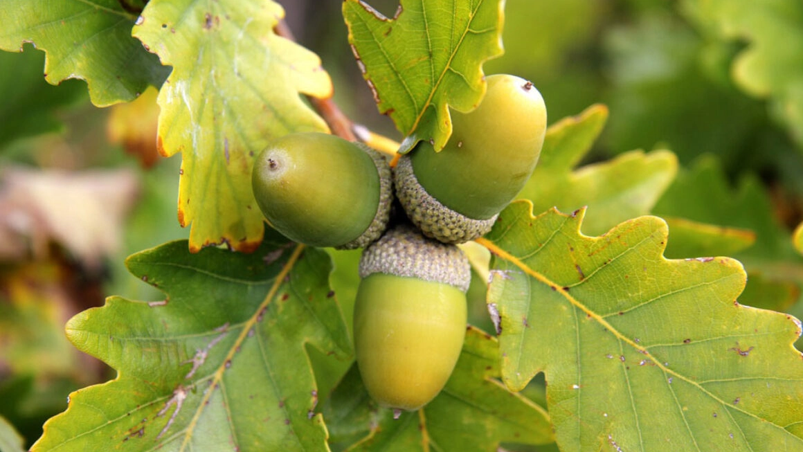
Why Is Client Leadership So Important?
|

Slide 5
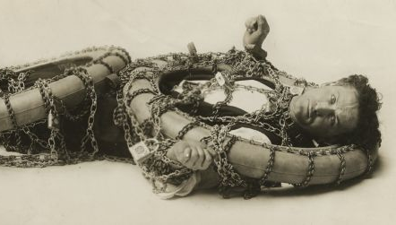
Retains Clients
|

Slide 6
Maximises
New Business ROI
|

Slide 7
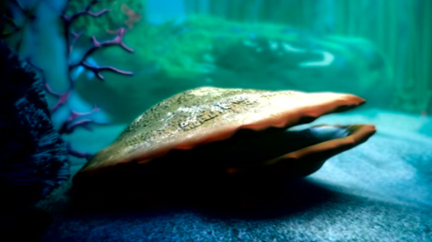
Highly Valued But
Rarely Seen
|
Notes:
Competitive advantage – washed out of business

Slide 8
Project-Led
The Now
Tactical
Delivery
Input-Focused
Fair Value
Service-Led
The Future
Strategic
Added Value
Output-Focused
Premium Value
Management
Vs
Leadership

Slide 9
CLIENT LEADERSHIP
Reality Check
CLIENT MANAGEMENT

Slide 10
S
M
A
R
T
Approaches
Setting Growth Targets
Proposals
Wins

Slide 11
Profile &
Reputation
£
Our
Ideal
Client
Client
Satisfaction
Internal
Motivation

Slide 12
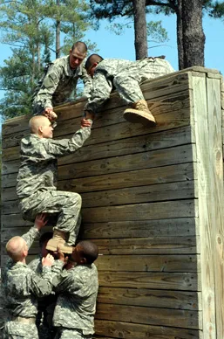
Perceived
Growable Clients -
Work Issues
Actual
Historic
Current
Notes:
Perceived – client believes but not / no longer real / the case

Slide 13
Perceived
Growable Clients - People Issues
Actual
Historic
Current

Slide 14
Client
Expects
Agency
Delivers
+ / -
--------------------------------------------------------------------
Strategy Insights
Data
--------------------------------------------------------------------
Creative Ideas
Solutions
Recommendations
------------------------------------------------------
------------------------------------------------------
------------------------------------------------------
------------------------------------------------------
Growable Clients
--------------------------------------------------------------------
Production
Delivery
--------------------------------------------------------------------
Project Management
Account Management
--------------------------------------------------------------------
Cost
ROI
--------------------------------------------------------------------
Highlight : High / Medium / Low
Notes:
11.45am
Flipchart

Slide 15
CLIENT RELATIONSHIP
Existing
New
Current
Where
To Look
AGENCY PRODUCT & SERVICES
‘New’
New
Business
New
Notes:
Flipchart

Slide 16
When
To Ask
Annual Client Planning Cycles
Procurement
Reviews & Evaluations
‘When The Light Shines’

Slide 17
Spotter’s Mindset
|
Notes:
12.45

Slide 18
Cue Blind
Cue Conscious
Cue Seeker
In Three
Minds

Slide 19
Client Knowledge & Insights
You, Your Experience & Exposure
What Cue Seekers
Do
Your Agency Experience & Capabilities

Slide 20
Walk Their Walk
|

Slide 21
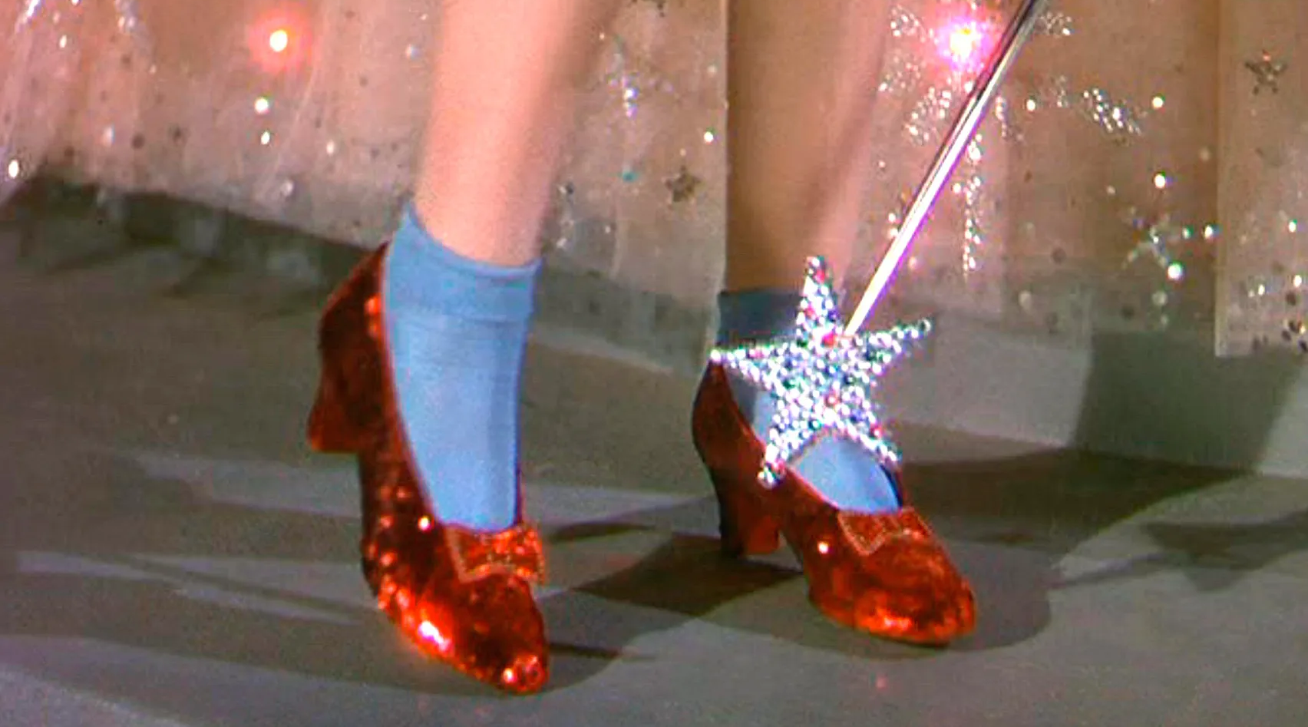
In Their
Customers’
Shoes
|
Notes:
Cereal Partners
CX – someone has planned / invested in that.
CapitalOne – DM vs. Online Engagement - started in pitch / envelopes on walls…continued throughout relationship – monthly reports
Repeat for competitors….Egg, Lloyds Bank

Slide 22
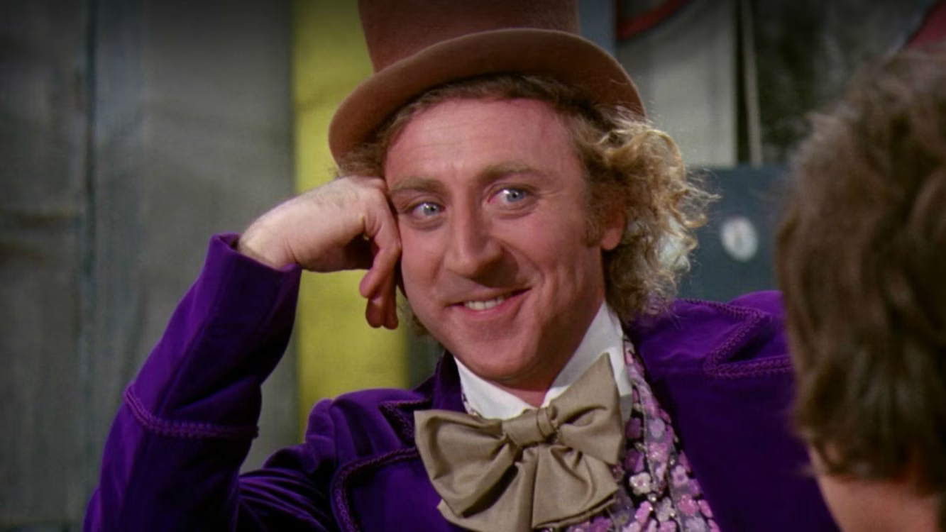
GO GROW
MARK CLARK
mark@jfdi.uk.com
O7711729319
|
Notes:
1.45pm
Willy Wonka takes a bow…

