Slide 1
Answering The Brief

Slide 2
Agenda
Criteria for success
Questions
How to make a great presentation
Questions

Slide 3
Set Brief Guidelines
The set brief accounts for 200 of your 280 marks.
The judges have a marking sheet with the following criteria
Check that you have covered off each element.
These marks will be awarded from the presentation:
Understanding of the brief, the brand, the target audience and competitors | /10
A key proposition or purpose that is linked to the understanding of the target audience | /30
A compelling strategic approach to solving the client problem that links directly to your consumer insight/understanding | /50
A brave and compelling idea that further enhances the brand purpose | /50
Communications. An integrated channel mix appropriate for the brand, audience participation and the budget | /30
Measurement criteria. A well thought through approach as to how the campaign will be measured | /15
Presentation skills | /15

Slide 4
Presentation
You will have 25 minutes to present and 5 minutes for questions. Please ensure you present within time.
You can choose to present in whatever format you wish, remember to use the skills that you learnt at the Presentation Module.
Do not be nervous about the presentation, the judges want you to do well and won’t be asking difficult questions.

Slide 5
General Guidance
Read the brief thoroughly
Plan ahead
Don’t rush it
Practice
Make assumptions – if you don’t have all the information you would like, make some sensible assumptions

Slide 6
Marking
The marks of the set brief will be added to the marks for the modules. The thresholds for grades are as follows:
Distinction 80%+
Merit 70 – 79%
Pass 56 – 69%
Fail Less than 55%

Slide 7
TIPs
On making a great presentation

Slide 8
Begin at the end

Slide 10
My idea is X
It is highly motivating for our audience(s) because of Y
It will be both distinctive and effective because of Z

Slide 11
Write slides that get you to this conclusion

Slide 12
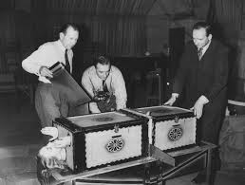
Cut the number of slides in half

Slide 13
Congratulations

Slide 14
Now turn it into a story

Slide 17
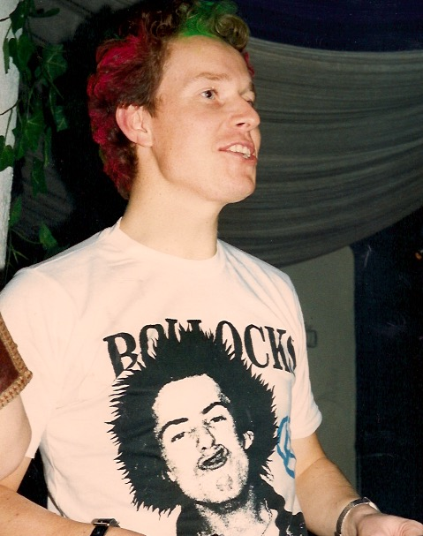
Get personal
The efforts you went to
Your road to Damascus moment

Slide 18
Don’t

Slide 19
Don’t put too many works on a slide. It’s tempting because you worry you might miss something important. But in fact as soon as someone sees a slide with loads of words on it they get slightly anxious. And if you present lots of slides with lots of words on them in small typefaces then people get tired and slight pissed off. You will probably just read out the words on the slides as I am doing now and that is looks insecure, uncertain and unconvincing.
Then you will make then trawl through 20 more wordy slides before you reveal your (TA DA) brilliant idea. But by then you will have lost them. Their eyes will glaze over, their energy levels will drop and they will start to think abut the shopping they have to do or just desperately want the whole thing to end so they can go home

Slide 20
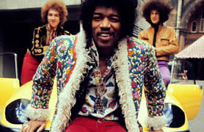
Don’t worry if you are a snappy dresser
Go for it. Be yourself.

Slide 21
Don’t be afraid
to use humour

Slide 22
Remember…

Slide 24
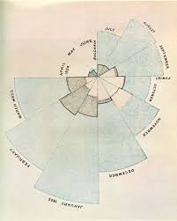
And persuasive

Slide 25
Do’s

Slide 26
Stand up
Tell the story with pictures (as much as possible)
Use chunking
Enjoy sharing your ideas
Let your personality and enthusiasm shine through

Slide 27
Maybe..
Make it interactive ?

Slide 28
Definitely
Sum up
(your idea and why it’s great)

