Slide 1
Presenting with Impact
Tessa Morton
Lesley Vickerage

Slide 3
Information Dynamic Purpose
Map your journey Act I, II and III
Performance Energy and connection
Allies Stop and Breathe
Creativity Originality
Test Practice and feedback

Slide 4
Information
1
2
3
4
Why?
What?
Who?
How?
Notes:
We recruit the best people in the industry so this means that your colleagues are very good
Our offices are located in Weybridge, Madrid, Prague and around the world. All have free car parking.
Benefits package includes on-site gym, health care insurance, and lots of holiday time
Facilities back-up support with 24/7 emergency phone line with dedicated support

Slide 5
Information
Functional purpose – What do you want the audience to do?
Dynamic purpose – What do you want the audience to feel?

Slide 6
Mapping
1
Act 1
hook
2
Act 11
interest
3
Act 111
Strong feeling
Notes:
We recruit the best people in the industry so this means that your colleagues are very good
Our offices are located in Weybridge, Madrid, Prague and around the world. All have free car parking.
Benefits package includes on-site gym, health care insurance, and lots of holiday time
Facilities back-up support with 24/7 emergency phone line with dedicated support

Slide 7
Performance
1
2
3
4
Bring to life
Audience
relationship
Energy
Congruency
Notes:
We recruit the best people in the industry so this means that your colleagues are very good
Our offices are located in Weybridge, Madrid, Prague and around the world. All have free car parking.
Benefits package includes on-site gym, health care insurance, and lots of holiday time
Facilities back-up support with 24/7 emergency phone line with dedicated support

Slide 8
38%
Aural
55%
Visual
7%
Verbal

Slide 9
+
Virtual performance
01
02
03
Position
Posture
Projection
Proximity and centering
Effect on you and
the audience
Landing your points, make an impact
Disruption
Disconnect
04
05
06
Distraction
Where do you want the focus to be?
Effective facilitation
Conscious interactive moments

Slide 10
Allies
1
2
3
4
Stop
Breathe out
Count to 3
Notice
Notes:
We recruit the best people in the industry so this means that your colleagues are very good
Our offices are located in Weybridge, Madrid, Prague and around the world. All have free car parking.
Benefits package includes on-site gym, health care insurance, and lots of holiday time
Facilities back-up support with 24/7 emergency phone line with dedicated support

Slide 11
Creativity
1
2
3
4
Point of
difference
Being you
original
Right brain
stimulus
Notes:
We recruit the best people in the industry so this means that your colleagues are very good
Our offices are located in Weybridge, Madrid, Prague and around the world. All have free car parking.
Benefits package includes on-site gym, health care insurance, and lots of holiday time
Facilities back-up support with 24/7 emergency phone line with dedicated support

Slide 12
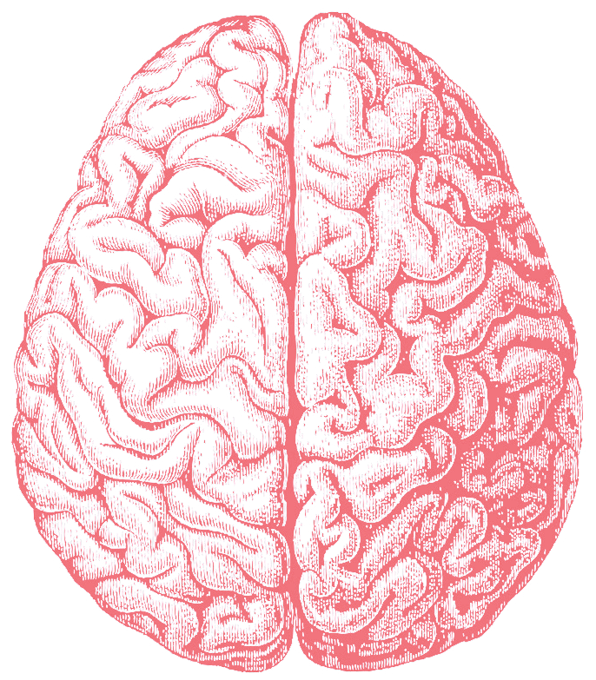
Logic
Order
Fact
Numbers
ST Memory
Creative
Emotions
Images
Concepts
LT memory

Slide 13
Test
1
2
3
4
Practice
Feedback
Refine
Practice
Notes:
We recruit the best people in the industry so this means that your colleagues are very good
Our offices are located in Weybridge, Madrid, Prague and around the world. All have free car parking.
Benefits package includes on-site gym, health care insurance, and lots of holiday time
Facilities back-up support with 24/7 emergency phone line with dedicated support

