Slide 1


HOW TO EXCEL AT PUBLIC SPEAKING

Slide 2
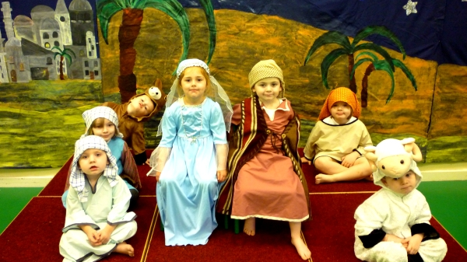

Slide 3
Don’t fidget
Don’t forget your lines
Speak loudly

Slide 4
It’s not normal
It’s brand new every time
Everyone is looking at you

Slide 5






Information Dynamic Purpose
Map your journey Act I, II and III
Performance Energy and connection
Allies Stop and Breathe
Creativity Originality
Test Practice and feedback

Slide 6

Information
1
2
3
4
Why?
What?
Who?
How?
Notes:
We recruit the best people in the industry so this means that your colleagues are very good
Our offices are located in Weybridge, Madrid, Prague and around the world. All have free car parking.
Benefits package includes on-site gym, health care insurance, and lots of holiday time
Facilities back-up support with 24/7 emergency phone line with dedicated support

Slide 7
Information
Functional purpose
–
What do you want the audience to do?
Dynamic purpose
–
What do you want the audience to feel?

Slide 8
Mapping
1
Act 1
hook
2
Act 11
interest
3
Act 111
Strong feeling
Notes:
We recruit the best people in the industry so this means that your colleagues are very good
Our offices are located in Weybridge, Madrid, Prague and around the world. All have free car parking.
Benefits package includes on-site gym, health care insurance, and lots of holiday time
Facilities back-up support with 24/7 emergency phone line with dedicated support

Slide 9
Performance
1
2
3
4
Bring to life
Audience
relationship
Energy
Congruency
Notes:
We recruit the best people in the industry so this means that your colleagues are very good
Our offices are located in Weybridge, Madrid, Prague and around the world. All have free car parking.
Benefits package includes on-site gym, health care insurance, and lots of holiday time
Facilities back-up support with 24/7 emergency phone line with dedicated support

Slide 10
38%
Aural
55%
Visual
7%
Verbal

Slide 11
+
01
02
03
Position
Posture
Projection
Proximity and centering
Effect on you and
the audience
Landing your points, make an impact
Disruption
Disconnect
04
05
06
Distraction
Where do you want the focus to be?
Effective facilitation
Conscious interactive moments

Slide 12
Effective facilitation
1
2
3
4
Warmth
Assertive
Clarity
Sign posting
Notes:
We recruit the best people in the industry so this means that your colleagues are very good
Our offices are located in Weybridge, Madrid, Prague and around the world. All have free car parking.
Benefits package includes on-site gym, health care insurance, and lots of holiday time
Facilities back-up support with 24/7 emergency phone line with dedicated support

Slide 13


REMOTE/LIVE
Practically difficult – I can’t see, I can’t hear, I don’t have access to the documents.
Psychologically difficult – not feeling included, unequal participation erodes trust in the process, the person and also what’s being discussed.

Slide 14



What can you do?
Plan for the challenge. Be prepared knowing what the challenges are.
Tec ready – do you and your team have the equipment at the office to be able to bring the 2 groups together so people can see and hear each other ? = connected practically
Engagement ready – does everyone feel part of the action, seen and able to respond ? = connected emotionally

Slide 15
+
01
02
03
Position
ROE
Inclusion
Dual audience
How the meeting will work
Equal participation
Disruption
Chemistry
04
05
06
Content share
Who gets what, when?
Effective facilitation
Pre, post, during
Conscious interactive moments

Slide 16
Allies
1
2
3
4
Stop
Breathe out
Count to 3
Notice
Notes:
We recruit the best people in the industry so this means that your colleagues are very good
Our offices are located in Weybridge, Madrid, Prague and around the world. All have free car parking.
Benefits package includes on-site gym, health care insurance, and lots of holiday time
Facilities back-up support with 24/7 emergency phone line with dedicated support

Slide 17
Creativity
1
2
3
4
Point of
difference
Being you
original
Right brain
stimulus
Notes:
We recruit the best people in the industry so this means that your colleagues are very good
Our offices are located in Weybridge, Madrid, Prague and around the world. All have free car parking.
Benefits package includes on-site gym, health care insurance, and lots of holiday time
Facilities back-up support with 24/7 emergency phone line with dedicated support

Slide 18


Logic
Order
Fact
Numbers
ST Memory
Creative
Emotions
Images
Concepts
LT memory

Slide 19
Agenda
Q4 Sales Update
Latest Orders
Future Pipeline Business (UK only – excluding Ireland)
Product launches for 2024
Customer Reviews
Project Evo update
New joiners to the team (May 2023)
AOB
Questions

Slide 20
What are we going to cover today?
1
2
3
4
Sales
Update
New
Product
Launch
Staff
Changes
New
Governance
Notes:
We recruit the best people in the industry so this means that your colleagues are very good
Our offices are located in Weybridge, Madrid, Prague and around the world. All have free car parking.
Benefits package includes on-site gym, health care insurance, and lots of holiday time
Facilities back-up support with 24/7 emergency phone line with dedicated support

Slide 21
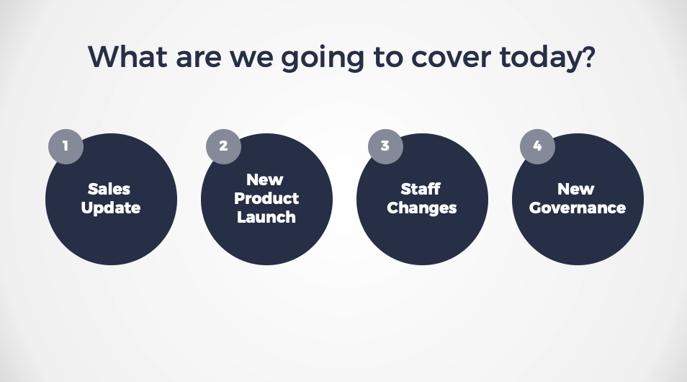
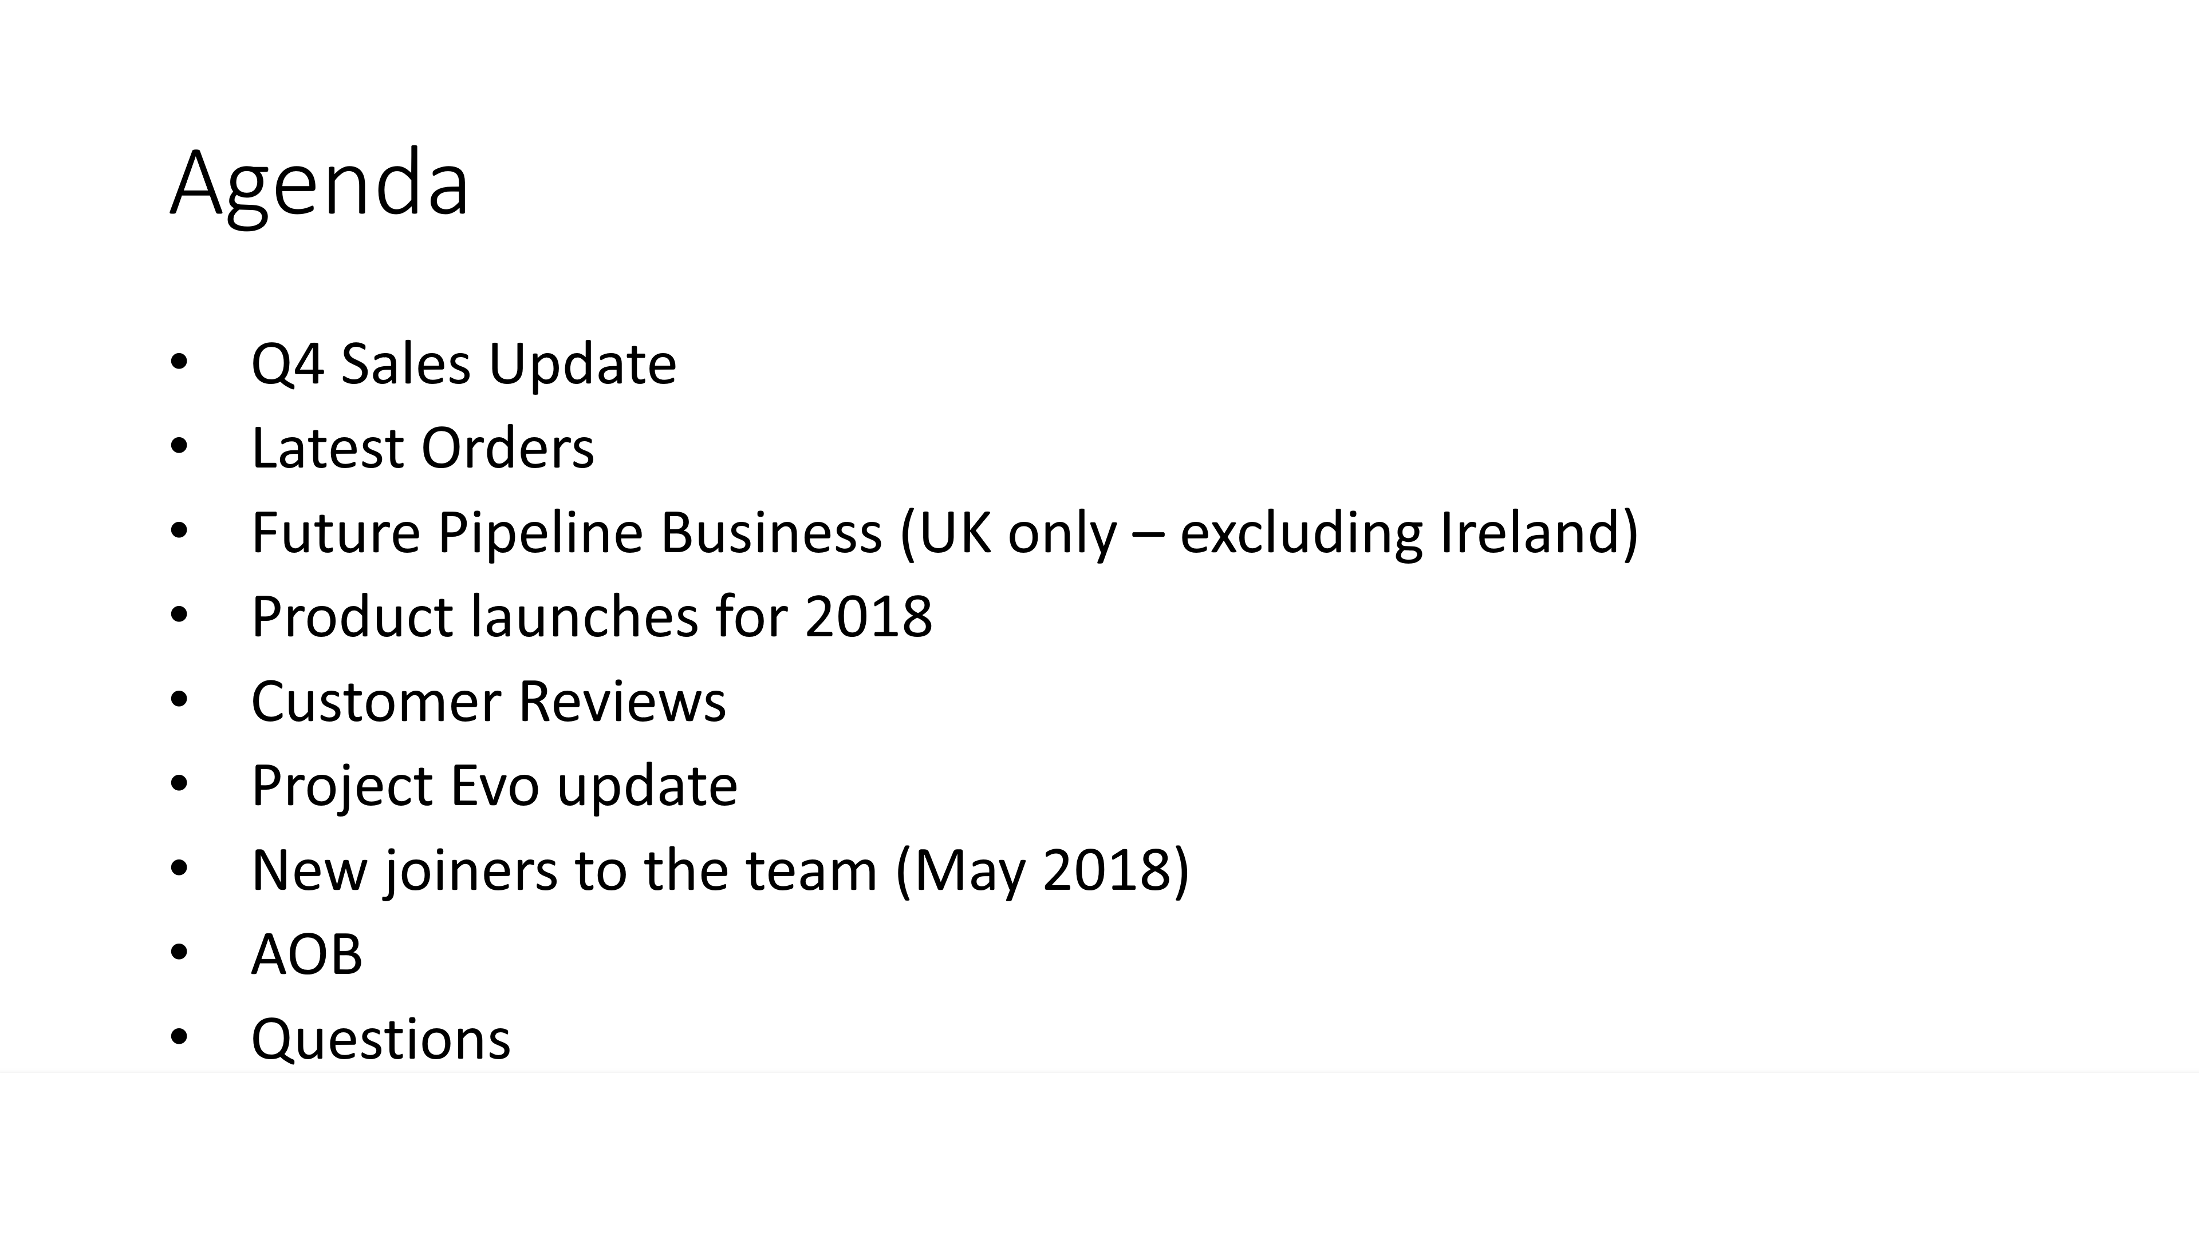
Before
After

Slide 22
Test
1
2
3
4
Practice
Feedback
Refine
Practice
Notes:
We recruit the best people in the industry so this means that your colleagues are very good
Our offices are located in Weybridge, Madrid, Prague and around the world. All have free car parking.
Benefits package includes on-site gym, health care insurance, and lots of holiday time
Facilities back-up support with 24/7 emergency phone line with dedicated support

