Slide 1
Leadership Pathway Programme Launch Meeting April 2024

Slide 2
TODAY’S AGENDA
Introductions
Why the Leadership Pathway Programme
The Programme
The Networking Events
The Seminars
The Mentors
Agency of the Future

Slide 3
WHY TH E LEADERSHIP PATHWAY?
Prepare you for agency leadership roles
No other programme just for agency people
Be inspired
Build a network
Future proof your career
Notes:
So here we are today 100 agencies strong
representing 7000 people as the UK’s leading Trade Body for the independent agency community
That’s really important as we have programs for all in the agencies not matter what role or seniority

Slide 4
THE PROGRAMME
Five Live Networking Events
Nine Workshops
Mentoring
Agency of the Future
Notes:
So here we are today 100 agencies strong
representing 7000 people as the UK’s leading Trade Body for the independent agency community
That’s really important as we have programs for all in the agencies not matter what role or seniority

Slide 5
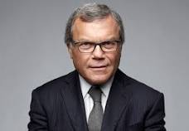
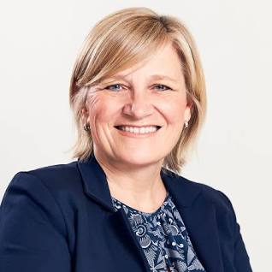
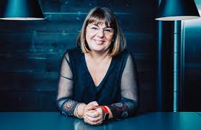
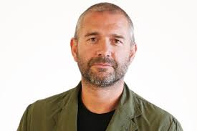
NETWORKING EVENTS
Live events. 6.30pm to 8.30pm. Unparalleled quality of speakers
Sir Martin Sorrell - The Qualities of an Outstanding Agency Leader on 25th April
Alessandra Bellini - Building Long Term Client Relationships on 20th June
Rankin – Creating a Fertile Creative Culture on 19th September
Ian Millner – The Successful Start up on 17th October
Dame Cilla Snowball – Resilience on 18th November
Interview format, small group size, use the opportunity
Notes:
Some big hitters in that council, but we’re the only ones who solely represent independent agencies, this is also our interface into government so we can lobby on your behalf.

Slide 6
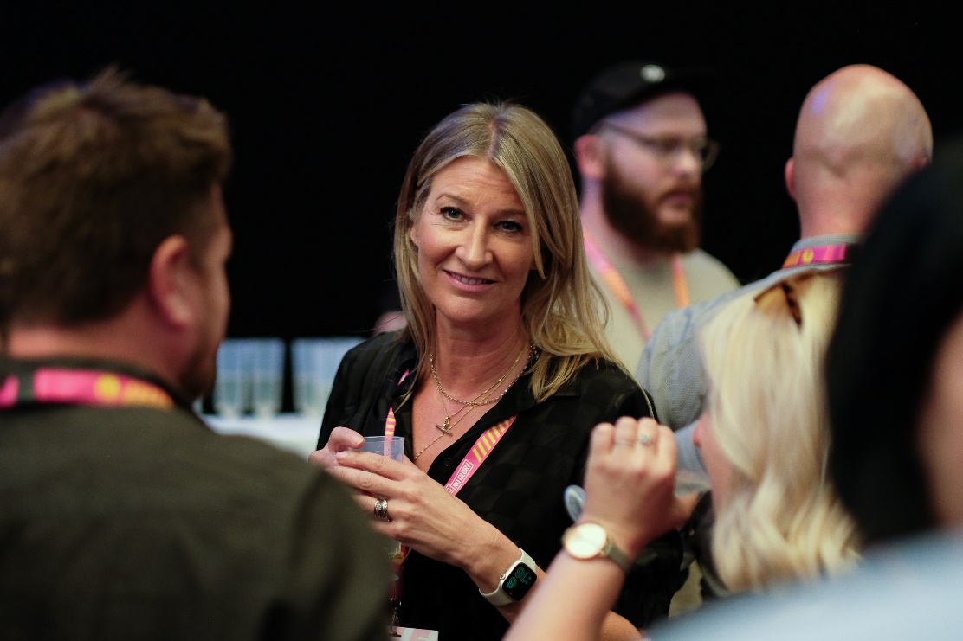
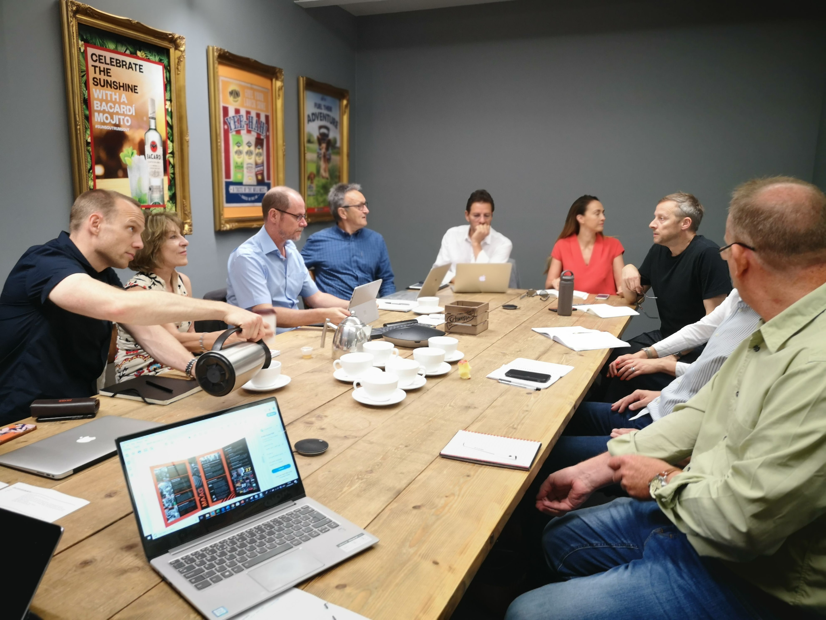
SEMINARS
Nine seminars
5 live and 4 online
Half day plus one full day
Diarise and prioritise
All slides will be shared on portal
Recorded where possible

Slide 7
MENTORING
“Off-line help by one person to another in making transitions in knowledge, work or thinking”
Mentoring is help by one person to another to make changes in knowledge, work or thinking. It is different to coaching.
Mentors tend to be experts in the same field as you
They offer advice and share experiences
You should all have your mentor details
You should lead contact.
Expectation – 3 sessions during the programme
Relationship is confidential

Slide 8
AGENCY OF THE FUTURE
Split into groups to work on what The Agency of the Future might look like
Group 1 – Louise, Jon, Imogen and Ash
Group 2 – Sophia, Julie, Holly and Stephen
Group 3 – Jasman, Mike and Sophie
Group 4 – Jess, Emma and Alice
Each seminar should provide food for thought – be sure to capture
Pricing/Product/Talent/Competition/Branding
Present to a group of agency leaders at the end of the programme
Notes:
People Pulse every quarter, 10-12 questions for a temperature check of agencies – questions such as: are you offered Learning & development opportunities, how would you rate your agencies approach to sustainability, can you voice your opinions within your agency.
Many of our agencies then use this information to present back to their teams, if you receive 6 or more responses you will receive a personalised benchmarking report of your agency vs all the other agencies who participated that quarter. We normally receive 500+ responses, we take out the key learnings and present them back to you along with Question & Retain our third party partner for the surveys.

Slide 9
COMMUNICATION
WhatsApp Group
The Portal
Suzanne@allindependentagencies.org
Tracey@allindependentagencies.org

